Slide 1
UPFRONT-MUD STUDY
Upfront bone marrow transplantation from a matched unrelated donor in children with idiopathic aplastic anemia
Results of the final statistical report — median follow-up 24.4 months [IQR 23.8–25.8]
Phase II, national, multicenter trial — SFGM-TC / AP-HP
Prof. Jean-Hugues Dalle · Prof. Régis Peffault de Latour (coordinating investigators)
Funding: French Ministry of Health — PHRC-N 2019 | Sponsor: AP-HP (DRCI) | NCT05419843

Slide 2
Background and scientific rationale
1
Immunosuppressive therapy (IST): a long-term “dead end”
In children with idiopathic aplastic anemia and no family donor, first-line IST yields a 5-year failure-free survival of only about 13%, leaving a lasting risk of relapse and clonal evolution.
1.0
0.8
0.6
87.5% (95% CI, 78–97)
Survival probability
0.4
0.2
0.0
0
12
24
36
48
60
72
Time (months)
N. at risk
61
53
38
35
33
30
28
Saint Louis experience. Konopacki J, et al. Haematologica 2012.
2
MUD HSCT vs IST

Slide 3
Background and scientific rationale
Transplantation from a matched unrelated donor (MUD) has improved markedly
2
Similar outcome of upfront-unrelated and matched sibling stem cell transplantation in idiopathic paediatric aplastic anaemia. A study on behalf of the UK Paediatric BMT Working Party, Paediatric Diseases Working Party and Severe Aplastic Anaemia Working Party of EBMT
Dufour C et al, BJH 2015
No prospective study
UPFRONT-MUD — Final report (median follow-up 24.4 months)
2

Slide 4
Objectives and methods
Primary objective
Study design
Perform MUD transplantation within 60 days of identification of a matched donor.
Phase II, national, multicenter, prospective, single-arm (15 SFGM-TC centers)
Simon two-stage minimax design: success if ≥ 70% vs ≤ 45% deemed unacceptable
Interim analysis planned after 12 enrollments
Target: 25 patients, with ≥ 16 successes required overall
Secondary objectives
Engraftment, graft failure
Acute and chronic GvHD
Progression-free survival, relapse, non-relapse mortality, overall survival
Severe infections, CMV/EBV reactivations
Quality of life, chimerism, immune reconstitution
UPFRONT-MUD — Final report (median follow-up 24.4 months)
3

Slide 5
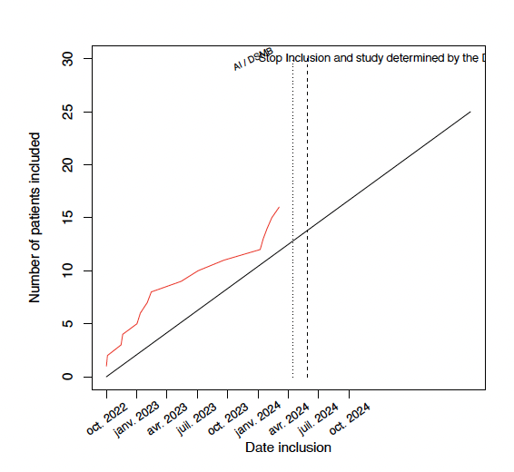
Study population
Enrollment from October 10, 2022 to March 13, 2024 — 9 active French centers
17
16
15
patients registered
in the registry
patients enrolled
in the study
patients actually
transplanted
Main baseline characteristics
Enrollment by center
Median age: 9 years [IQR 6–11]
Balanced sex ratio (8 girls / 8 boys)
Sorror score = 0 in 75% of patients
PNH clone detectable in 50% of patients
Prior platelet transfusion in 80% of patients
UPFRONT-MUD — Final report (median follow-up 24.4 months)
4

Slide 6
Primary endpoint: feasibility of upfront transplantation
68.5 d
31%
Early termination
median time from registry
listing to transplant [58–83]
of transplanted patients
within 60 days (5/16)
recommended by the DSMB after
the interim analysis (April 2024)
Cumulative incidence of transplantation after patient registry listing
Nearly all patients ultimately transplanted
But most often beyond 60 days
No severe infectious complication prevented transplantation during the wait.
UPFRONT-MUD — Final report (median follow-up 24.4 months)
5

Slide 7
Engraftment and graft-versus-host disease (GvHD)
Engraftment
Cumulative incidence of acute GvHD after transplantation
100%
D30
of transplanted patients
(15/15)
median time to
engraftment [28.5–32.5]
Acute and chronic GvHD
20%
13%
D20: 6.7% · D30: 13.3% · D180: 20.0%
All 3 episodes of acute GvHD responded favorably to first-line corticosteroid therapy.
Acute GvHD (3/15)
all steroid-sensitive
Chronic GvHD (2/15)
grade 2
UPFRONT-MUD — Final report (median follow-up 24.4 months)
6

Slide 8
Infections and safety
27%
33%
11/15
13/15
CMV reactivation
(cumulative incidence 26.7% at 24 months)
EBV reactivation
(cumulative incidence 33.3%)
patients with at least one
severe infection (grade 3–4)
patients with at least one
serious adverse event
!
One death reported
One patient died on day 46 post-transplant from EBV reactivation. No other deaths were observed throughout follow-up, including at 24 months.
17 severe infectious events (grade 3 to 5) in total, with a median time to onset of 106 days [78–118] post-transplant. Main causes: sepsis, CMV, EBV, and other infections.
UPFRONT-MUD — Final report (median follow-up 24.4 months)
7

Slide 9
Survival and clinical outcomes — now with extended follow-up
ASH 2024
Key message
Median follow-up: 11.6–12 months
With follow-up now twice as long as that presented at ASH 2024, results are confirmed and stable:
1-year overall survival: 93.3% [81.5–100]
No relapse observed
1 death (D46–D60, EBV-PTLD)
overall survival remains high and stable over time (~93%)
no relapse has occurred, including beyond 12 months
the only death observed occurred before D60 post-transplant
chronic GvHD remains limited (2 patients, grade 2)
Final report — September 2026
Median follow-up: 24.4 months [23.8–25.8]
14/15 transplanted patients still alive (~93%)
Still no relapse at 24 months
No additional deaths since ASH 2024
UPFRONT-MUD — Final report (median follow-up 24.4 months)
8

Slide 10
Chimerism, immune reconstitution, and quality of life
Whole-blood chimerism (% donor cells)
Quality of life (PedsQL score)
Questionnaires collected at enrollment, post-transplant, then at M3, M6, M12, and M24, for both child and parent
Scores improved progressively over time, particularly in adolescents (13–18 years): median score from 67 pre-transplant to 94 at M24
Small numbers at each time point (5 to 8 evaluable patients depending on age group): encouraging trend to be confirmed
Immune reconstitution (CD3+ lymphocytes, /µL)
Continuous increase through M24: from 80/µL (M3) to 1,339/µL (M24)
UPFRONT-MUD — Final report (median follow-up 24.4 months)
9

Slide 11
Conclusions and perspectives
Upfront MUD transplantation is feasible and safe if it can be performed within a “reasonable” time frame
Results are confirmed with longer follow-up
Systematic rituximab remains essential (off-label; dose? Day of administration?)
NEVERTHELESS and IN PRACTICE
In the absence of a rapidly available donor (60? 75? days), first-line immunosuppressive therapy should be preferred and started without delay.
UPFRONT-MUD study — NCT05419843 — SFGM-TC / AP-HP — PHRC-N 2019

