Slide 1
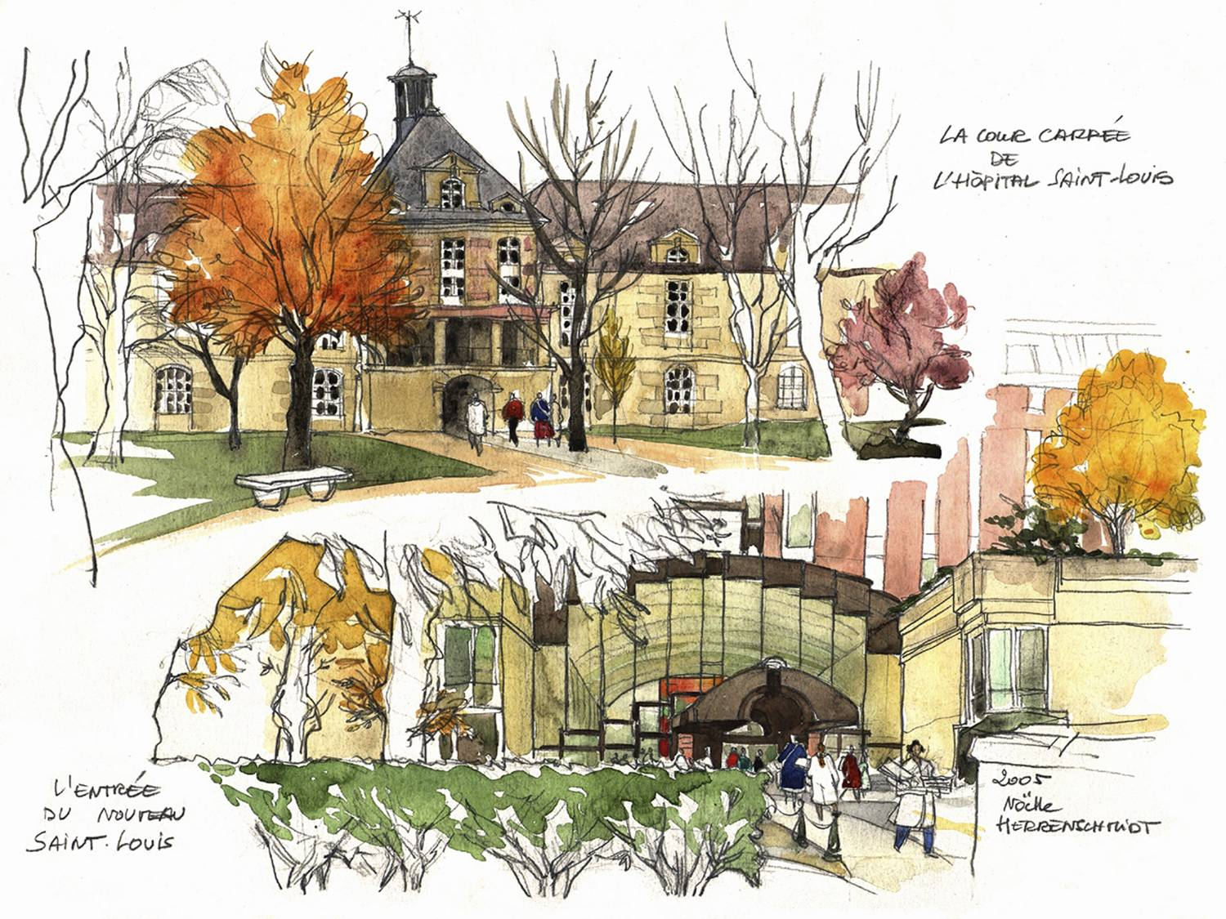



Hémolyse sous inhibiteurs proximaux et suivi des patients (IDEC/IPA)
Régis Peffault de Latour, MD, PhD
French reference center for aplastic anemia & PNH
French network for rare immunological & hematological disorders (MaRIH)
Severe aplastic anemia working party of EBMT (SAAWP EBMT)
Hôpital Saint-Louis, Paris, France

Slide 2
Breakthrough hemolysis
Régis Peffault de Latour, MD, PhD
French reference center for aplastic anemia & PNH
French network for rare immunological & hematological disorders (MaRIH)
Severe aplastic anemia working party of EBMT (SAAWP EBMT)
Hôpital Saint-Louis, Paris, France

Slide 3


BTH - Definition
Event of hemolytic exacerbation with or without clinical signs/symptoms, including thrombosis, in a patient with PNH on complement therapies.
BTH was defined as the occurrence of at least 1 new or worsening sign or symptom of IVH* in the presence of LDH of ≥2ULN (after prior reduction of LDH to <1.5× the ULN on treatment).
*Symptoms of IVH: fatigue; hemoglobinuria; abdominal pain, dyspnea; major adverse vascular events including thrombosis, dysphagia, or erectile dysfunction. Anemia, namely Hb of <10 g/dL, was also included among signs of IVH.

Slide 4
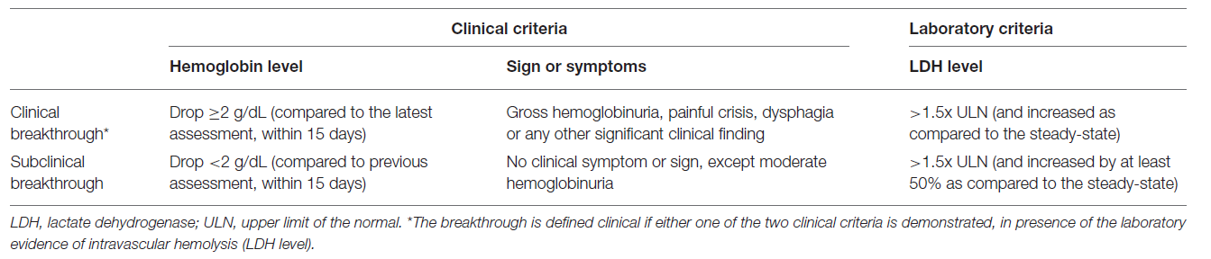





BTH - Classification
Clinical breakthrough hemolysis - appearance of clinical symptoms such as painful hemolytic crises and dark urines (somehow subjective), associated with a rise in LDH and a drop in hemoglobin
2. Subclinical breakthrough hemolysis - evident just by laboratory data (i.e., LDH or haemoglobin) and moderate hemoglobinuria
Risitano et al. Front Immunol 2019
Notes:
Bathrooms are located on both floors (2nd and 3rd Floor)
Enter the auditorium from 2nd floor, late arrivals enter from 3rd floor to avoid disruption
Take waste/garbage with you from the auditorium.
The sessions will be recorded for on-demand viewing (posted to the website for 30 days)
Turn your phones off.
Wi-Fi: SickKidsGuest & Pwd: beourguest

Slide 5
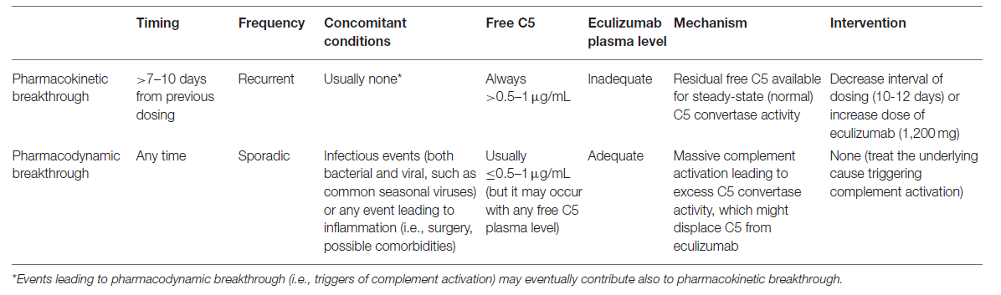
BTH – 2 Mechanisms
1. Pharmacokinetic
  Suboptimal inhibition due to inadequate drug levels
  Occurs regularly, usually just before reinjection
  of Ravulizumab
2. Pharmacodynamic
  Occurs despite adequate drug levels
  Under strong complement activation conditions (e.g. pregnancy, infection, surgery etc)
5
Risitano et al. Front Immunol 2019
Notes:
Bathrooms are located on both floors (2nd and 3rd Floor)
Enter the auditorium from 2nd floor, late arrivals enter from 3rd floor to avoid disruption
Take waste/garbage with you from the auditorium.
The sessions will be recorded for on-demand viewing (posted to the website for 30 days)
Turn your phones off.
Wi-Fi: SickKidsGuest & Pwd: beourguest

Slide 6
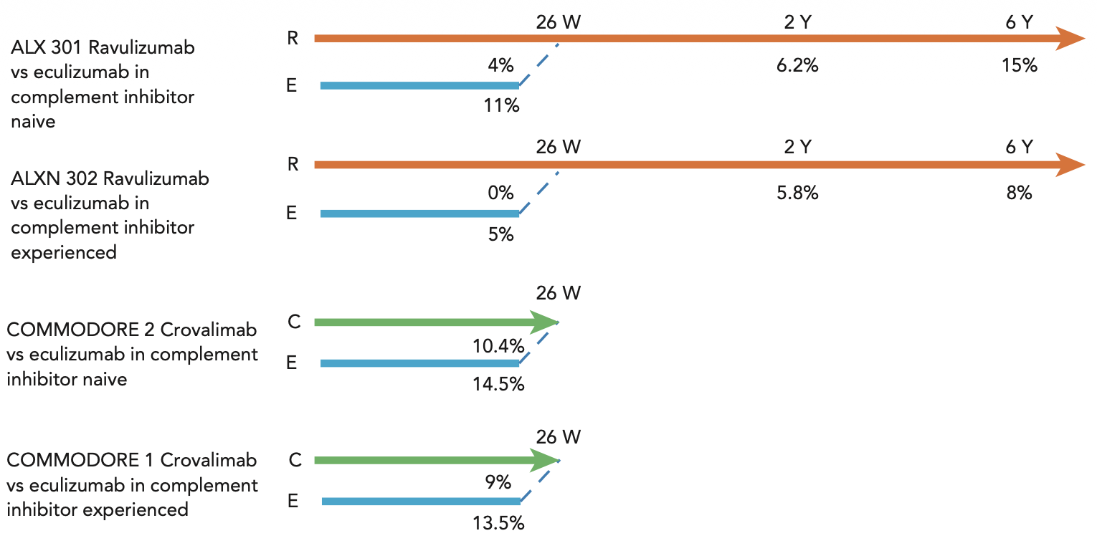
BTH with anti C5 complement inhibitors - Trials
Fattizzo, et al. Blood 2025

Slide 7

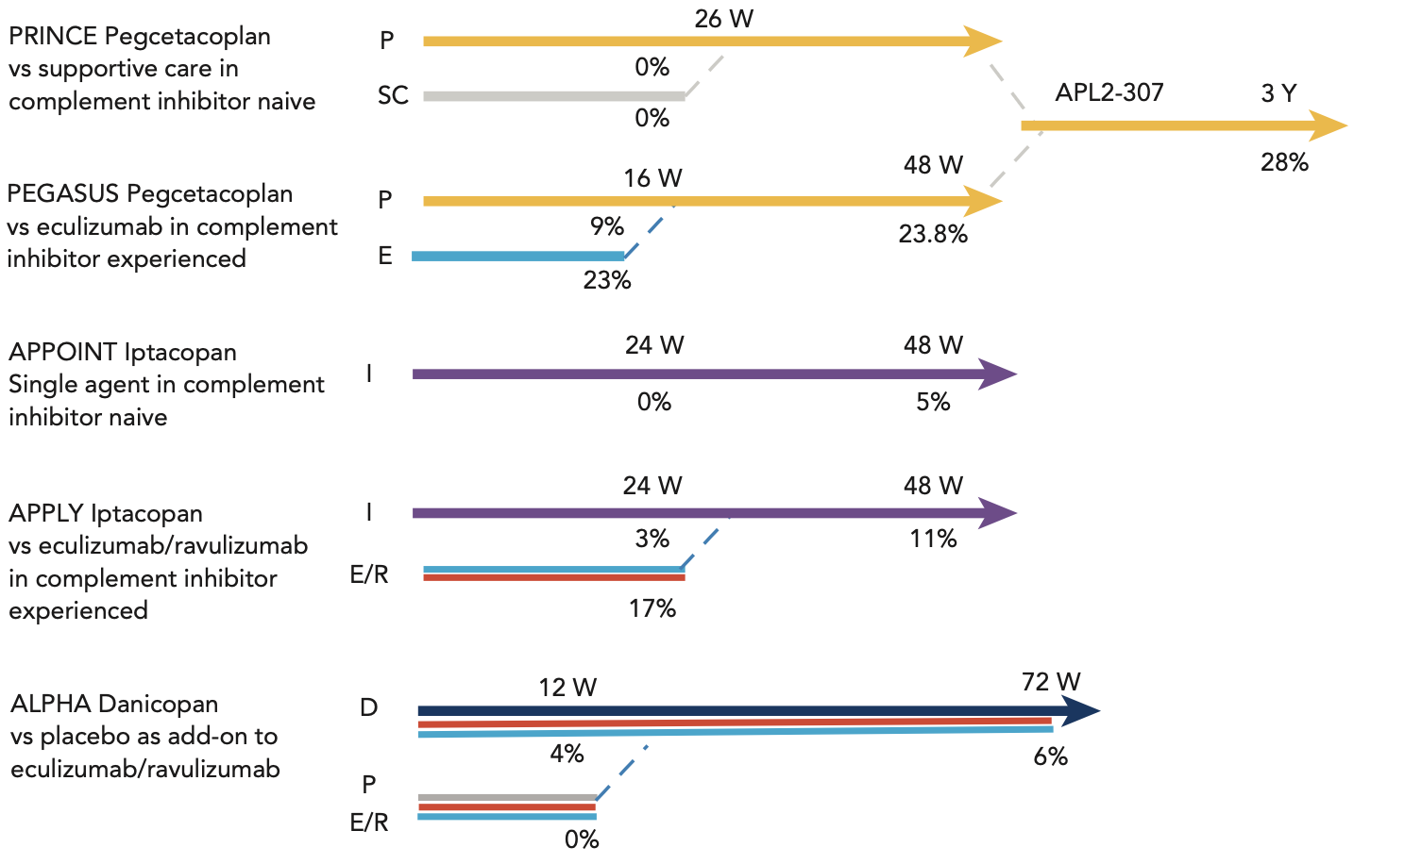
BTH with proximal complement inhibitor - Trials
Fattizzo, et al. Blood 2025

Slide 8
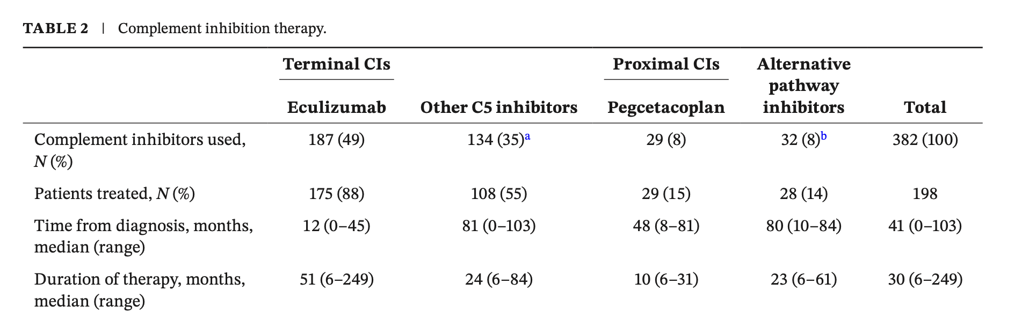
BTH – all complement inhitors – Real life
Fattizzo, et al. AJH 2025

Slide 9
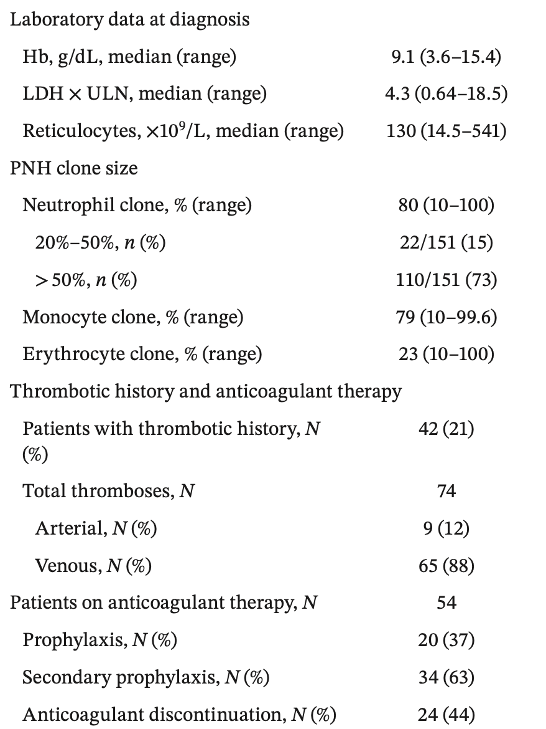
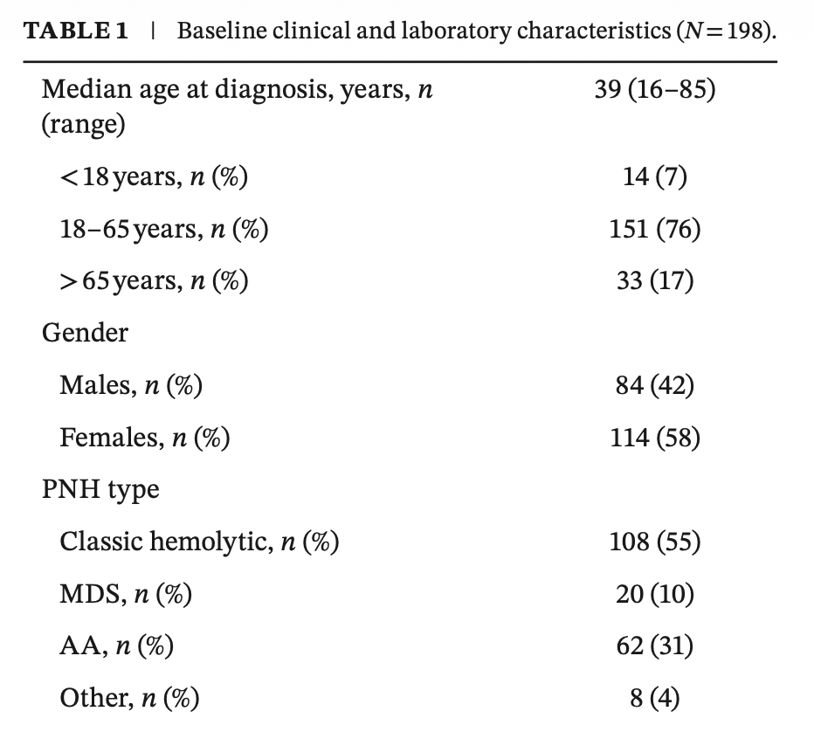
BTH – all complement inhitors – Real life
Fattizzo, et al. AJH 2025

Slide 10
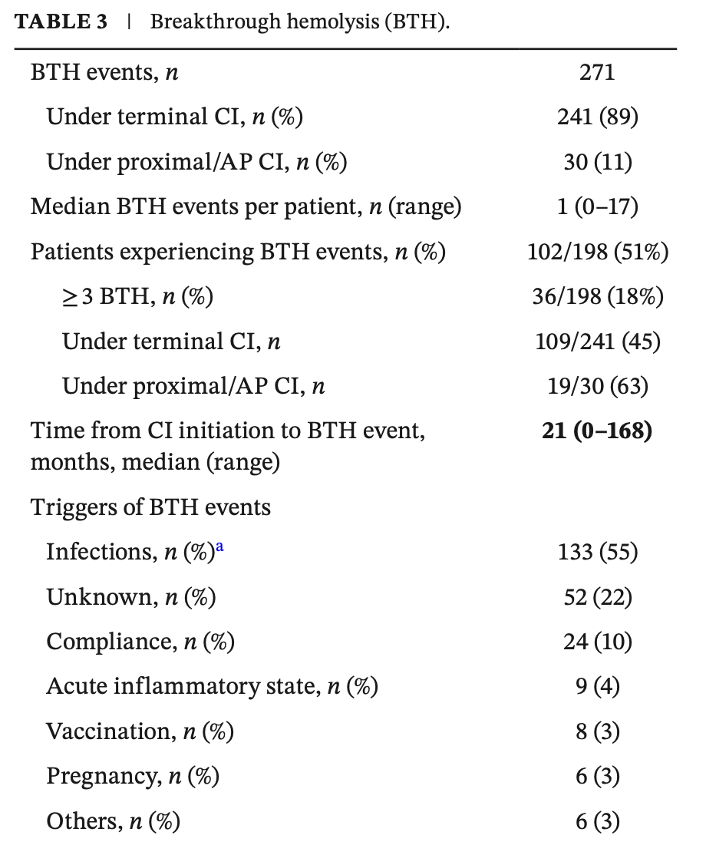
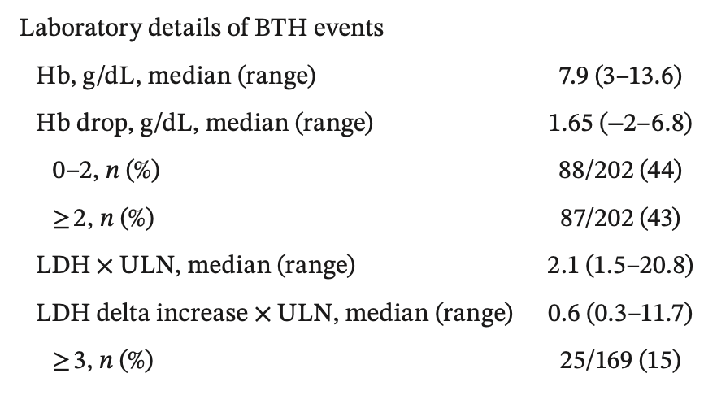
BTH – all complement inhitors – Real life
Fattizzo, et al. AJH 2025
Notes:
~ 80 % of patients in both arms maintained transfusion avoidance at week 72
Mean LDH levels remained well-controlled near normal (and < 1.5 x ULN)
from baseline to week 72 in both treatment arms
No new safety signals identified. No meningococcal infections or discontinuations due to hemolysis

Slide 11
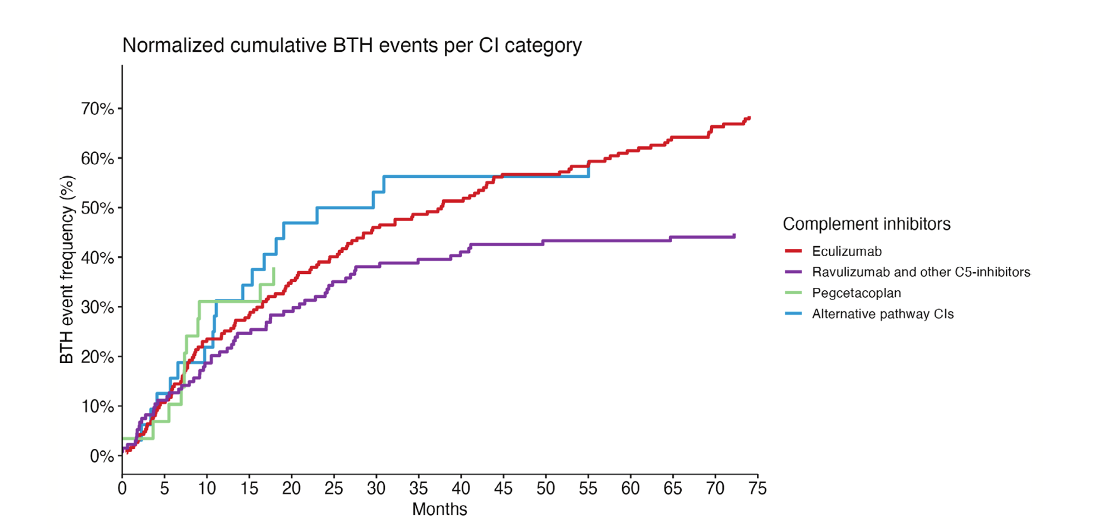
BTH – all complement inhitors – Real life
0.18 events per pts-year of treatment
0.43
Iptacopan: 0.45 events per pts-year of treatment
Danicopan: 0.20 events per pts-year of treatment
Fattizzo, et al. AJH 2025

Slide 12
BTH – all complement inhitors – Real life
Survival PNH cases post drug commencement – All cases
Median time from CI treatment to the first BTH event was shorter for pegcetacoplan (7 months, 0–18) compared to eculizumab (34, 1–168), other anti-­ C5 drugs (13, 0–72), and AP inhibitors (11, 2–55).
Fattizzo, et al. Blood 2025

Slide 13

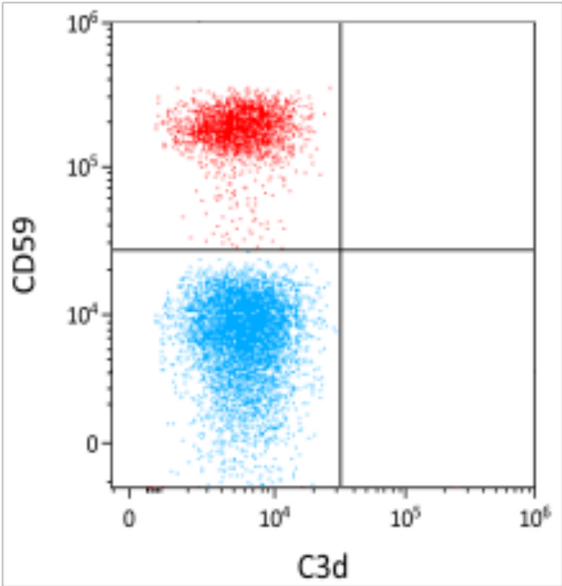

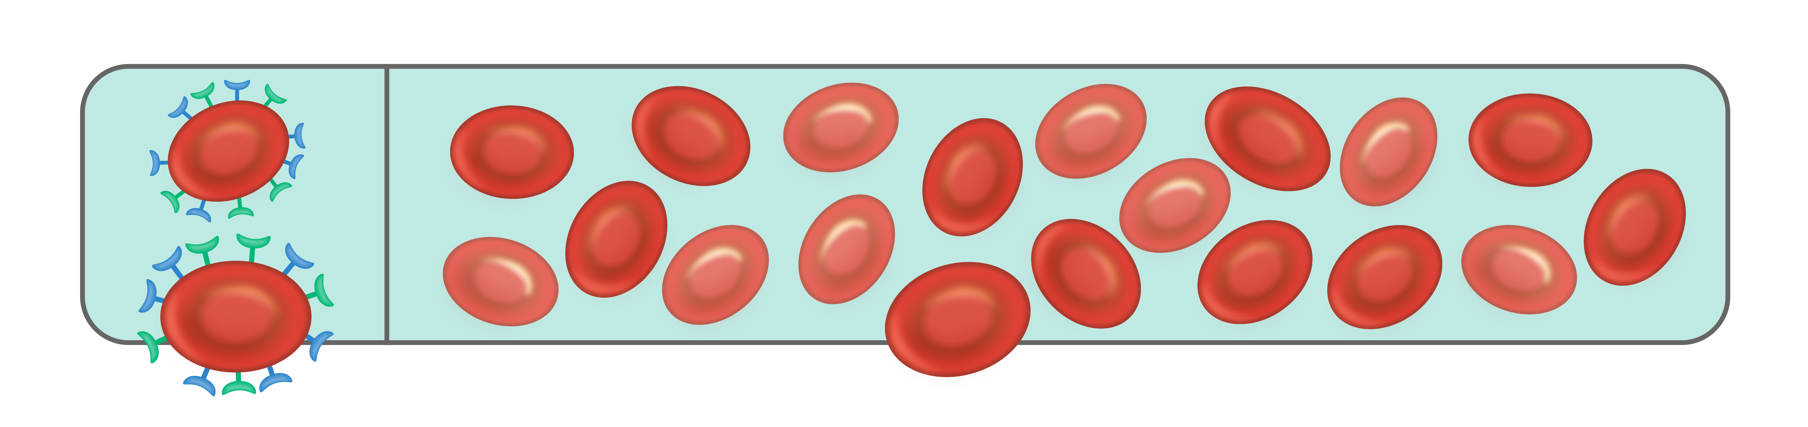
« Complete » proximal inhibition in PNH
C3
C3
C3
Factor B
Factor D
Factor B
Factor D
Factor B
Factor D
Patient treated with proximal complement inhibitor²
C3b
C3b
C3b
C3 convertase
(C3bBb)
C3 convertase
Bb
Bb
Bb
C3b
C3b
C3b
C5 convertase
C3b_{n}
C3b_{n}
C3b_{n}
C5 convertase
(C3b_{n}Bb)
Bb
Bb
Bb
C5
C5
C5
C5
C5
C5
C5
C5
C5
C5
C5
C5
C5b-9 (MAC)
Normal red cells
PNH red cells
No hemolysis¹
BTH, breakthrough haemolysis; EVH, extravascular haemolysis; MAC, membrane-attack complex; PNH, paroxysmal nocturnal haemoglobinuria.
1. Figure adapted from Notaro R et al. N Engl J Med 2022;387:160–166; 2. Figure from personal library of Dr Rosario Notaro.

Slide 14
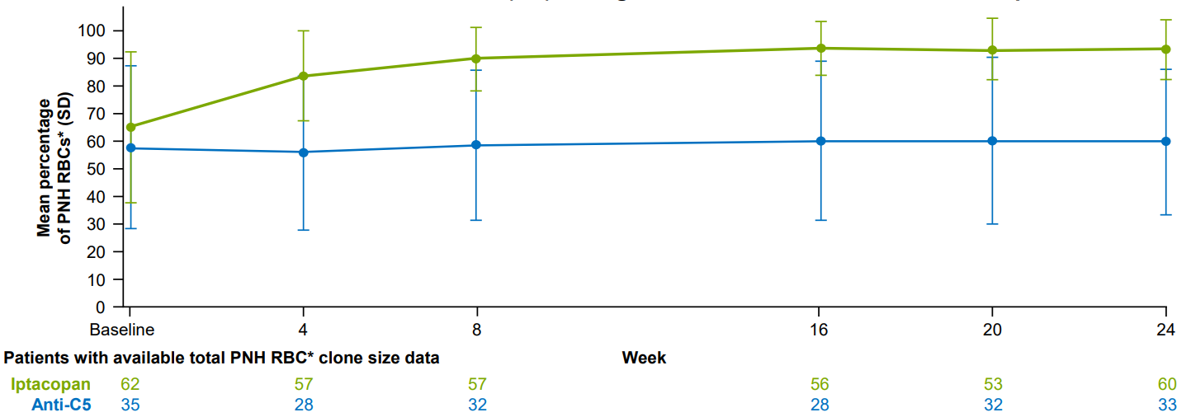
Proportion of PNH red cells on proximal inhibitors
Pegcetacoplan: Pharmacodynamic endpoints from
16-week randomised period of PEGASUS trial^{1a}
Iptacopan: Mean total PNH RBC* clone size (SD) during
the 24-week randomised treatment period of APPLY-PNH trial^{2b}
100
93.9%
80
72.9%
66.8%
62.6%
60
% of PNH RBC
40
20
0
Eculizumab arm
n= 39
Pegcetacoplan
arm
n= 41
Eculizumab
n= 37
Pegcetacoplan
n= 32
*Type II + type III PNH RBCs
Baseline on eculizumab
Week 16
ªPEGASUS is a Phase III open-label, controlled trial to assess the efficacy and safety of pegcetacoplan compared with eculizumab in adults with PNH and haemoglobin levels <10.5 g/dL despite eculizumab therapy. After a 4-week run-in phase in which all patients received pegcetacoplan plus eculizumab, patients were randomised to subcutaneous pegcetacoplan monotherapy (41 patients) or intravenous eculizumab (39 patients) for the 16-week randomized, controlled period.¹
^{b}APPLY-PNH is a Phase III, randomised, open-label trial to evaluate the efficacy and safety of twice-daily, oral iptacopan monotherapy (200 mg) for the treatment of PNH compared to anti-C5 therapies (eculizumab or ravulizumab) in adult patients
presenting with residual anaemia despite a stable regimen of anti-C5 treatment in the last six months prior to randomisation.⁴
Ecu, eculizumab; IPTA, iptacopan; Pegcet. pegcetacoplan; PNH, paroxysmal nocturnal haemoglobinuria; RBC, red blood cell; SD, standard deviation.
1. Hillmen P et al. N Engl J Med. 2021;384(11):1028-1037 (Supplementary Appendix); 2. Risitano AM et al. Oral presented at the European Hematology Association 2023 Congress, held in Frankfurt, Germany and virtually on 8–11 June 2023;
3. Aspaveli EU SmPC; 4. Peffault de Latour R et al. NEJM 2024

Slide 15
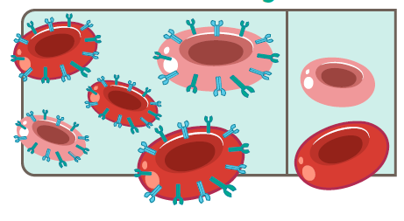
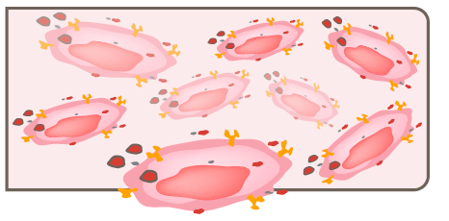
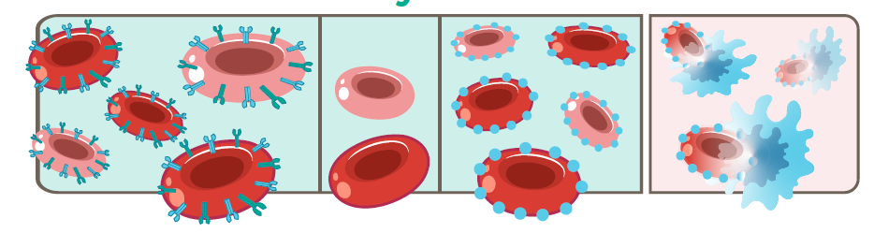
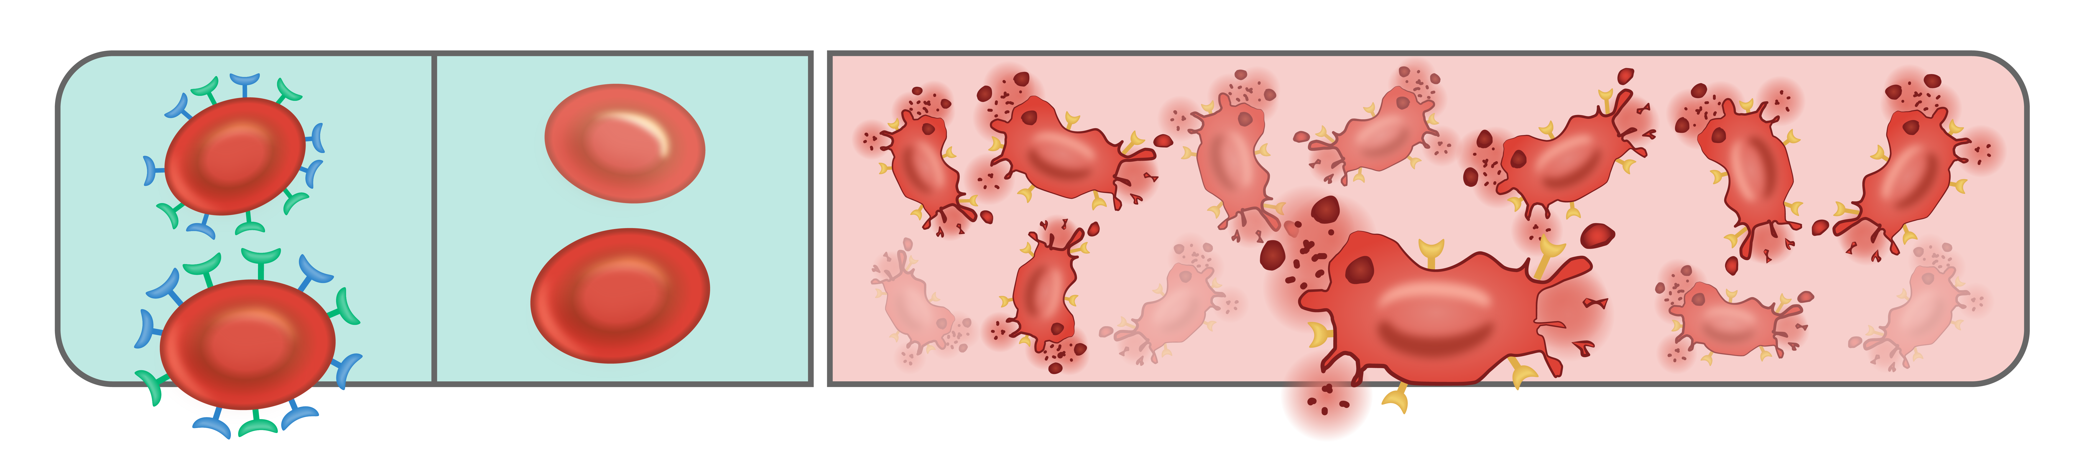
Breakthrough hemolysis – Clinical level
Untreated PNH
Normal red cells
PNH
red cells
Lysed PNH red cells
Incomplete
No hemolysis¹
Chronic or acute IVH¹
Incomplete
Terminal inhibition
Proximal inhibition
Normal red cells
PNH
red cells
C3-bound
PNH red cells
Phagocytosed
C3+ PNH red cells
PNH red cells
Normal red cells
No hemolysis¹
Chronic EVH¹
No hemolysis¹
PNH
red cells
C3-bound
PNH red cells
Lysed PNH
red cells
Phagocytosed
C3+ PNH
red cells
PNH
red cells
Normal red cells
Normal red cells
Lysed PNH red cells
Acute BTH¹
No hemolysis¹
Chronic EVH¹
No hemolysis¹
Acute BTH¹
Figures adapted from Notaro R et al. N Engl J Med 2022¹
BTH, breakthrough haemolysis; MAC, membrane-attack complex; PNH, paroxysmal nocturnal haemoglobinuria.
1. Notaro R, Luzzatto L. N Engl J Med. 2022;387(2):160–166.

Slide 16

Breakthrough hemolysis – Complement level
Incomplete C3 inhibition
Incomplete C5 inhibition
Complete C3 inhibition
Complete C5 inhibition
C3
C3
C3
C3
C3
C3
C3
C3
C3
C3
C3
C3
Factor B
Factor D
Factor B
Factor D
Factor B
Factor D
Factor B
Factor D
Factor B
Factor D
Factor B
Factor D
Factor B
Factor D
Factor B
Factor D
Factor B
Factor D
Factor B
Factor D
Factor B
Factor D
Factor B
Factor D
C3b
C3b
C3b
C3b
C3b
C3b
C3b
C3b
C3b
C3b
C3b
C3b
C3 convertase
(C3bBb)
C3 convertase
(C3bBb)
C3 convertase
(C3bBb)
C3 convertase
(C3bBb)
C3 convertase
C3 convertase
Bb
Bb
Bb
Bb
Bb
Bb
Bb
Bb
Bb
Bb
Bb
Bb
C3b
C3b
C3b
C3b
C3b
C3b
C3b
C3b
C3b
Amplification loop
C3b
C3b
C3b
Amplification loop
C3b_{n}
C3b_{n}
C3b_{n}
C3b_{n}
C3b_{n}
C3b_{n}
C3b_{n}
C3b_{n}
C5 convertase
C3b_{n}
C5 convertase
C3b_{n}
C3b_{n}
C3b_{n}
C5 convertase
(C3b_{n}Bb)
C5 convertase
(C3b_{n}Bb)
C5 convertase
(C3b_{n}Bb)
C5 convertase
(C3b_{n}Bb)
Bb
Bb
Bb
Bb
Bb
Bb
Bb
Bb
Bb
Bb
Bb
Bb
C5
C5
C5
C5
C5
C5
C5
C5
C5
C5
C5
C5
C5
C5
C5
C5
C5
C5
C5
C5
C5
C5
C5
C5
C5
C5
C5
C5
C5
C5
C5
C5
C5
C5
C5
C5
C5
C5
C5
C5
C5
C5
C5
C5
C5
C5
C5
C5
Incomplete c5 inhibition
C5b-9 (MAC)
C5b-9 (MAC)
C5b-9 (MAC)
C5b-9 (MAC)
PNH
red cells
C3-bound
PNH red cells
PNH
red cells
C3-bound
PNH red cells
Phagocytosed
C3-bound PNH red cells
PNH
red cells
Phagocytosed
C3-bound PNH red cells
Normal red cells
Lysed PNH red cells
Normal red cells
Normal red cells
PNH red cells
Normal red cells
Lysed PNH red cells
No haemolysis¹
Chronic EVH¹
No haemolysis
No haemolysis¹
No haemolysis
Acute BTH
Acute BTH
Chronic EVH
Figures adapted from Notaro R et al. N Engl J Med 2022¹
BTH, breakthrough haemolysis; MAC, membrane-attack complex; PNH, paroxysmal nocturnal haemoglobinuria.
1. Notaro R, Luzzatto L. N Engl J Med. 2022;387(2):160–166.

Slide 17
BTH management
1
2
3
4
5
Admit most cases; manage mild cases in out-patient setting
Consult hematology
Assess degree of hemolysis: CBC, reticulocytes, haptoglobin, LDH, bilirubin, urinalysis
Ensure the patient is adequately monitored
Work up infection; start broad-spectrum antibiotics (CNS-penetrant)
  Never stop the complement inhibitor
Review other possible triggers & complement inhibitor adherence
If C5 inhibitor: assess terminal inhibition
Identify the
underlying cause
Watch for end-organ damage; thrombosis work-up
Administer prophylactic anticoagulation in an in-patient setting²
Supportive transfusions²
If severe hemolysis, clinical deterioration, thrombotic complication, or life-threatening event: give rescue dose per agent
Manage and prevent complications
of BTH¹
Reinforce adherence, especially for self-administered SC/oral agents²
If C5 inhibitor levels underdosed: increase dose & monitor
Pegcetacoplan dosing can be increased to up to three times per week
Re-establish effective complement inhibition
Recognize CAC; seek medical advice early
Recognize signs and symptoms of IVH
Support accurate and comprehensive
patient education
Adapted from CITE Clinical Guidance: Breakthrough Hemolysis in Paroxysmal Nocturnal Hemoglobinuria v8.2 (accessed August 31, 2026).
BTH, breakthrough hemolysis; CAC, complement amplifying condition; CBC, complete blood count; CNS, central nervous system; C5, complement 5; IVH, intravascular hemolysis; LDH, lactate dehydrogenase; SC, subcutaneous.
1. Bienz M & Patriquin CJ. Hematology. 2025;2025(1):154–163; 2. Fattizo B, Versino F, & Barcellini W. Blood. 2025;146(4):411–421.

Slide 18
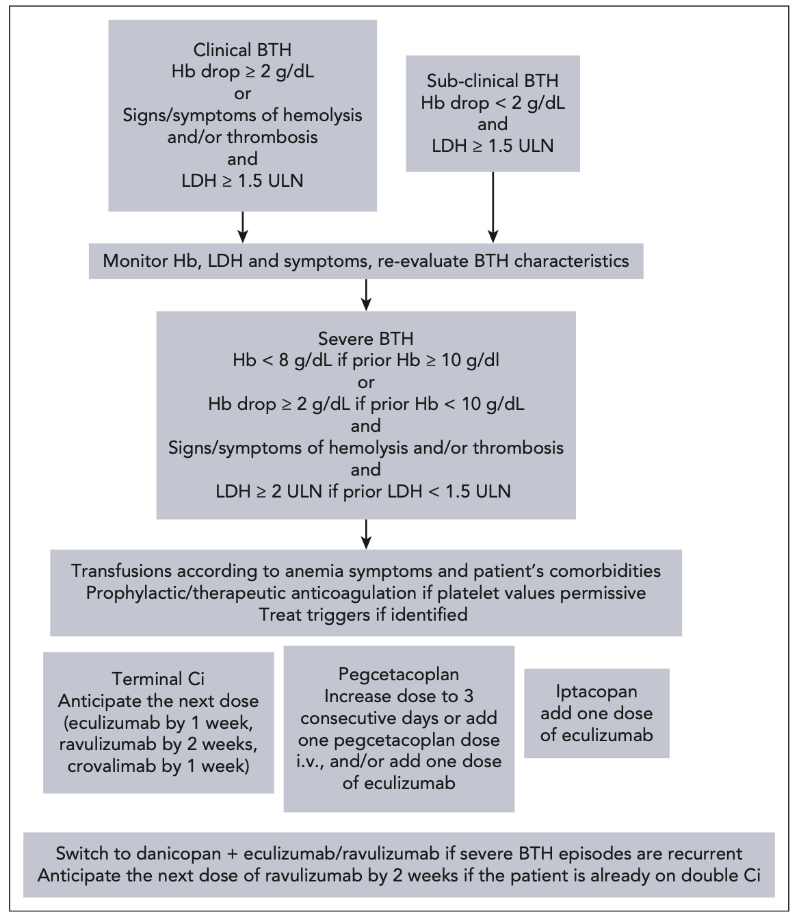
BTH management
Fattizzo, et al. AJH 2025

Slide 19
BTH - Conclusion
Definition - Subclinical versus clinical - Pharmacokinetic / Pharmacodynamic BTH
Proximals
  More events
  More severe
Early and quick management is outstandingly important
  Evaluation
  Treatment of the cause
  Evaluation after 3 days
  Education
IPA?

Slide 20
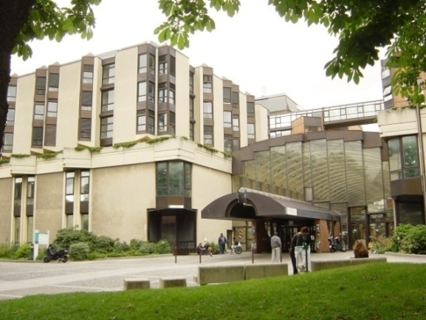

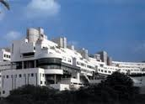
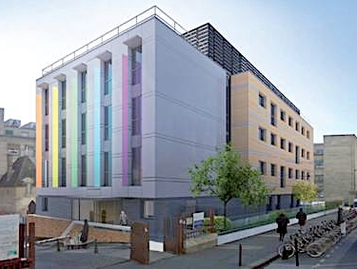



Thank you!
The French Reference Center for aplastic anemia and PNH in Paris
Saint-Louis Hospital Robert Debré Hospital Institute of Hematology, IUH St-Louis
  F Sicre, T Leblanc, JH Dalle, A Baruchel, G Socié,
  N Vasquez, W. Cuccuini, J Soulier (Fanconi team),
  C Kannengiesser, E Lainey, L Da Costa (Telomeres team)

Slide 21
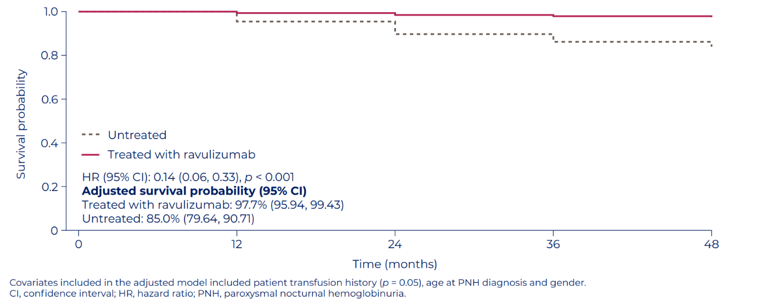
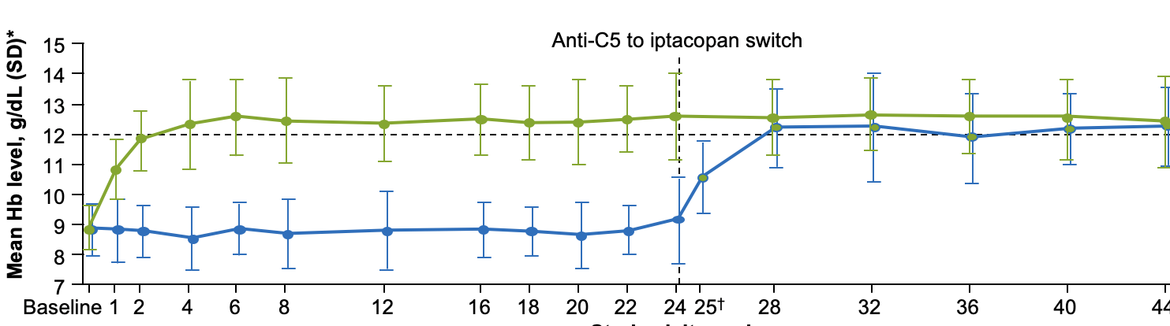
Conclusions
1995: devastating disease ¹
2015: overall survival ²
2025: hemoglobin normalization ³
Actuarial survival from the time of
diagnosis in 80 patients with PNH
100
80
Age- and gender-
matched controls
60
Patients surviving (%)
40
20
Patients with PNH
0
0
5
10
15
20
25
Years after diagnosis
PNH was associated with mortality and morbidity in PNH patients
Complement inhibition has revolutionized the field by saving lives and improving QOL
Patients might experience clinically significant EVH under anti-C5
Proximal inhibition real word data confirmed efficacy & safety from clinical trials
AA-PNH syndrome without hemolysis should be managed like isolated AA
1. Kelly, Blood 2011 ; 2. Kulasekararaj et al. Ann Hematol 2025 ; 3. Kulasekararaj et al. Blood 2025 ; 4. Presenter’s own opinion

Slide 22
UK experience of patients treated with C5 inhibitor
> Treatment outcomes
 | UK PNH patients (N=509)
Thromboses, n (%) | 23 (4.5)
Neisseria meningitidis infection, n (%) | 11 cases in 10 patients (2.0)
Fatalities due to Neisseria meningitidis, n (%) | 1 (0.2)
Clonal evolution to myelodysplasia, n (%) | 10 (2.0)
Clonal evolution to acute myeloid leukaemia, n (%) | 7 (1.4)
Death, n (%) | 91 (17.9)
Haematologic parameters
Mean haemoglobin 12 months after starting C5i, g/dL | 10.8 (n=421)
Mean haemoglobin 24 months after starting C5i, g/dL | 10.9 (n=374)
Requiring transfusions in the most recent 12 months on C5i, n (%) | 123/446 (27.6)
Kelly et al, Blood 2023

Slide 23
Practical assessment of patients with anemia on anti-C5
Commencement of Complement Inhibitor treatment
LDH
    Pharmacogenomic
    Inability of drug to bind to target
    > C5 polymorphism
    > FH polymorphism
    > Other unknown mechanism
Reduced
Unchanged
>1.5 x ULN
≤1.5 x ULN
Assess for C5 mutation
CH50 absent/low
Continue therapy and monitor
Other causes of high LDH should be evaluated
CH50 normal
Consider inadequate dosing (PK BTH)
Continue therapy
Pharmacodynamic
Pharmacokinetic
    Increase of the target
    > Complement amplifying conditions (CACs)
    > Pregnancy
    Lack of sufficient drug
    > Neutralisation of drug by antibody (Anti-drug antibodies: ADAs)
    > Iatrogenic- issues with access to drugs (very important)
    > Missed doses and prolongation of dosing interval
Clinically symptomatic extra-vascular hemolysis should be suspected once a systematic assessment has been done (including search for clonal evolution)
BTH, breakthrough hemolysis; CAC, complement- amplifying condition C5, complement component 5; CH50, 50% complement hemolytic activity correlated with plasma LDH; FH, factor H; LDH, lactate dehydrogenase;
PK, pharmacokinetic; PNH, paroxysmal nocturnal haemoglobinuria.
Kulasekararaj AG, et al. Am J Hematol. 2021;96(7):E232–E235.
Notes:
Figure:
Kulasekararaj 2021, Fig 1
Text:
Kulasekararaj 2021, p2D

Slide 24
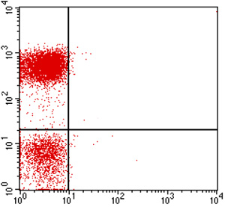
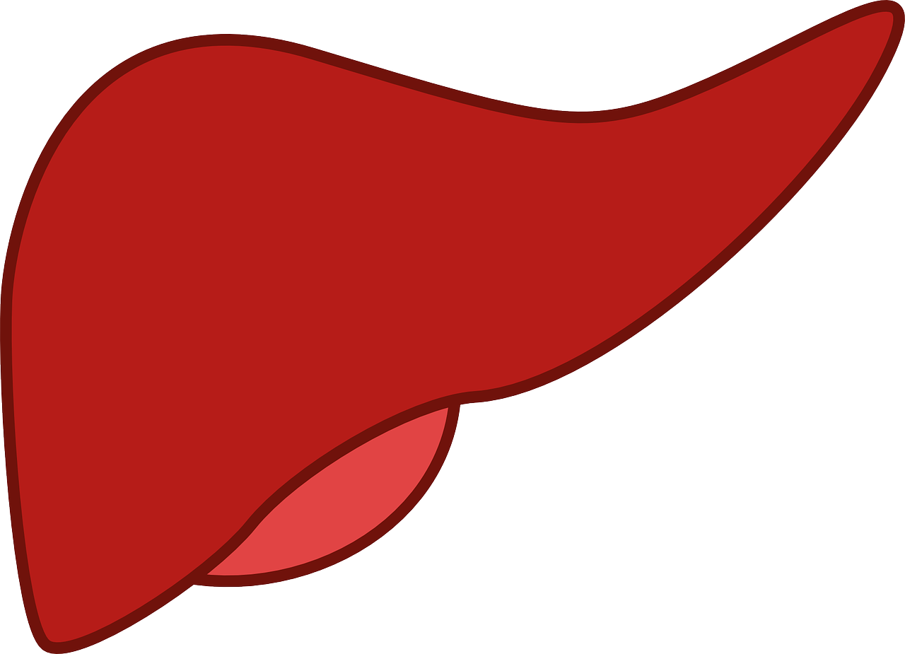
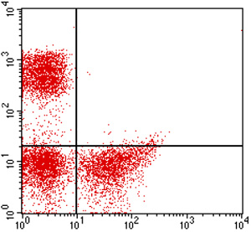


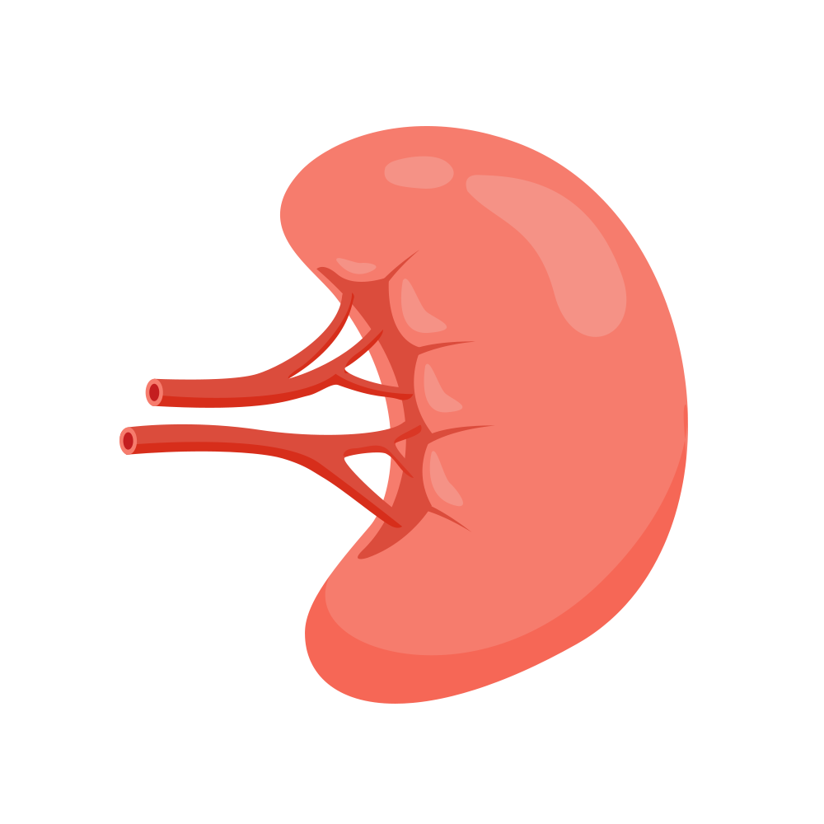
C5 blockade, C3 binding and de novo iatrogenic extravascular hemolysis
PNH Patient untreated²
C3
C3
C3
Factor B
Factor D
Factor B
Factor D
Factor B
Factor D
C3b
C3b
C3b
~30–40% of patients on terminal complement inhibition can develop clinically significant EVH^{3–5}
C3 convertase
(C3bBb)
C3 convertase
Bb
Bb
Bb
CD59-PE
Amplification loop
C3b
C3b
C3b
C5 convertase
C3b_{n}
C3b_{n}
C3b_{n}
C5 convertase
(C3b_{n}Bb)
Bb
Bb
Bb
C3-FITC
C5
C5
C5
C5
C5
C5
C5
C5
C5
C5
C5
C5
PNH Patient on eculizumab²
C5b-9 (MAC)
Normal red cells
PNH
red cells
C3-bound
PNH red cells
Phagocytosed
C3-bound PNH red cells
CD59-PE
C3d
45% of
PNH RBC
Chronic EVH
C3-FITC
Figure adapted from Notaro R N Engl J Med. 2022¹
EVH, extravascular haemolysis; MAC, membrane-attack complex; PNH, paroxysmal nocturnal haemoglobinuria; RBC, red blood cell.
1. Notaro R, Luzzatto L. N Engl J Med. 2022;387(2):160–166; 2. Figures from personal library of Dr Notaro; 3. Risitano AM et al. Blood 2009;113(17):4094-4100;
4. Kulasekararaj A et al. Presentation at EHA 2023. Abstract PB2056. Hemasphere 2023; 7(Suppl ): e35238f0; 5. Dubureaux PE et al. Bone Marrow Transplant. 2021;56(10):2600–2602.

Slide 25
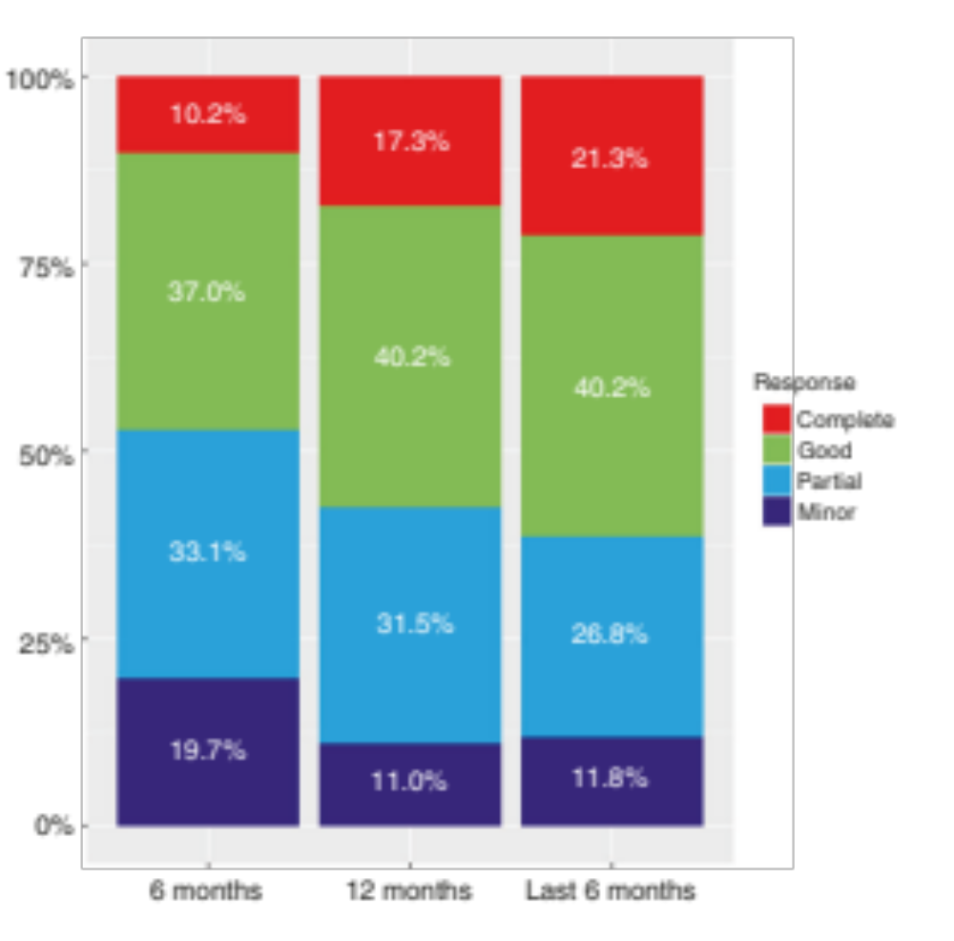
Extravascular hemolysis in clinical practice
International multicentric study:
(Paris, Naples/Avellino, London, Florence, São Paulo, and Ribeirão Preto)
- 160 patients HPN traités par eculizumab
- Median duration 5.8 years (0.5–14.5) (10% < 18 months)
- Censured for new treatment (35) of BMT (2)
- Dosage:
> 900 mg (83%)
> 1200 mg (17%)
38,6 %
Debureaux, et al. BMT 2021

Slide 26
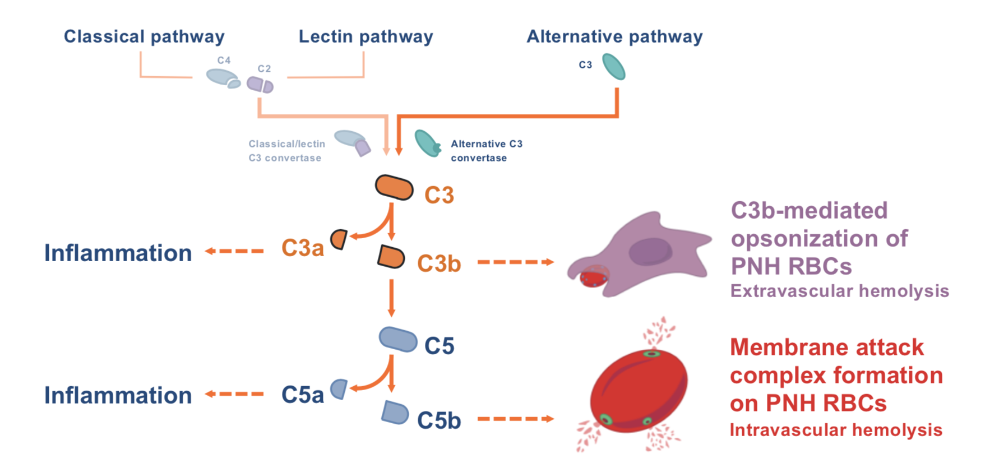
Untreated PNH

Slide 27
Terminal inhibition – on going EVH
C5 inhibition

Slide 28
Proximal inhibition – IVH control with no EVH
Proximal inhibition
C5 inhibition

Slide 29
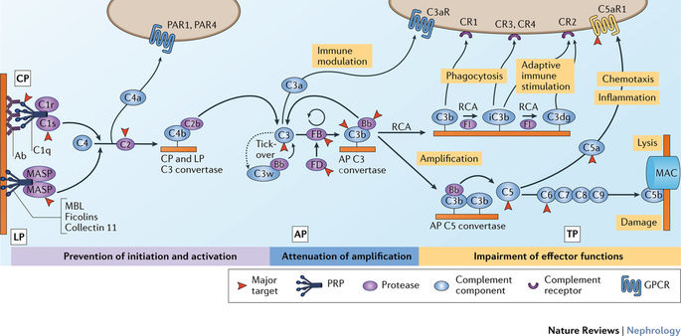
Proximal complement inhibitors
Anti-C3
(Pegcetacoplan)
Factor B inhibitor (Iptacopan)
Terminal complement inhibitors
X
X
Factor D inhibitor
(Danicopan)
C5
Debureaux, et al. BMT 2021

Slide 30
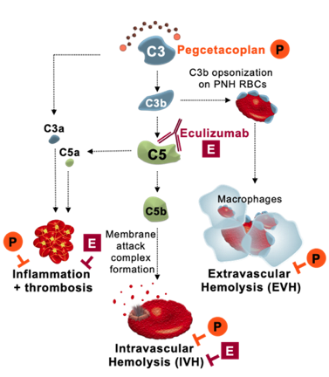
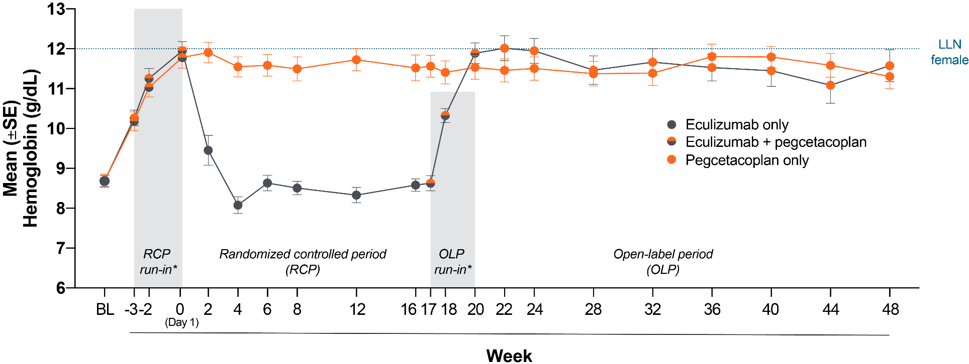
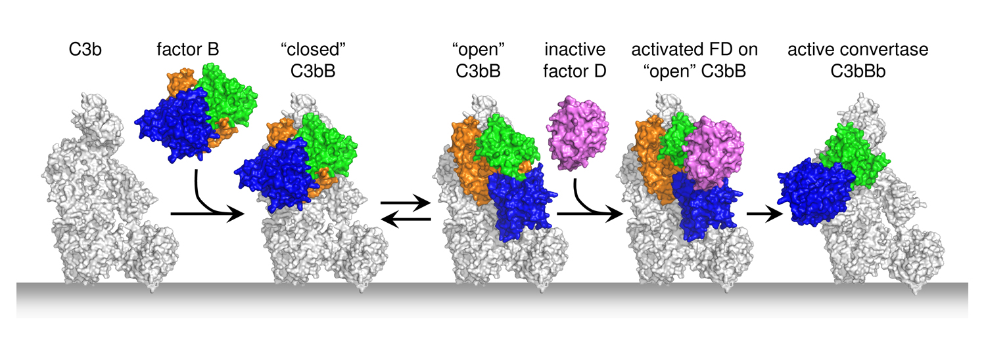
Pegcetacoplan – efficacy
Factor B
inhibitor
Iptacopan,
(oral, mono)
*Pegcetacoplan run-in periods: 1) before randomization, for both PEG-to-PEG and ECU-to-PEG treatment groups; and 2) before the open-label period, for the ECU-to-PEG treatment group only
All observed/uncensored for transfusion data
C3bBb
Sustained hemoglobin levels in the PEG-to-PEG group from Week 16 through Week 48 (no significant difference in hemoglobin levels between Week 16 and Week 48 in the PEG-to-PEG group; p=0.14ª)
Transfusion independency (70% of cases)
(C3bBb)C3b
FB
FB
C3bBb
Factor D
inhibitor
Danicopan
(oral, add-on)
C3b
C3b
C3bB
D
C3bBb
C5a
C3bB
C3
C5
C3bBb
C5b
Peffault de Latour et al. Lancet Haematology 2021

Slide 31
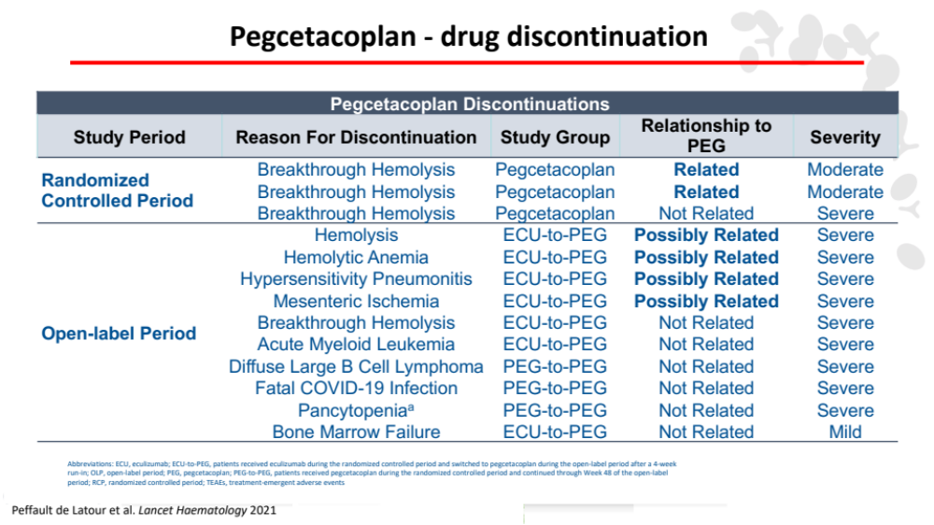
Factor B
inhibitor
Iptacopan,
(oral, mono)
C3bBb
(C3bBb)C3b
FB
FB
C3bBb
Factor D
inhibitor
Danicopan
(oral, add-on)
C3b
C3b
C3bB
D
C3bBb
C5a
C3bB
C3
C5
C3bBb
C5b

Slide 32
Intensive pegcetacoplan treatment regimens
307 acute hemolytic sub-study
Patients who had an acute hemolytic (AH) event warranting acute intervention (determined by investigator)
were eligible to receive intensive pegcetacoplan dosing
Intensive dosing
Maintenance dosing
1,080 mg
dose of IV pegcetacoplan
Next higher dosing frequency as before the AH episode†: 1,080 mg Q3D or TIW
AH episode:
LDH >2x ULN
with additional sign/symptom*
1st
2nd
3rd
1,080 mg
intensive SC pegcetacoplan
1,080 mg
intensive SC pegcetacoplan
1,080 mg
intensive SC pegcetacoplan
Next higher dosing frequency as before the AH episode: 1,080 mg Q3D or TIW
Day 1
Day 2
Day 3
Day 7
Day 14
Day 21
Day 28
3 months
Next
study visit
Repeat AH episode: LDH >2x ULN with additional sign/symptom*
Griffin et al. Blood Advances 2024
* e.g., decreased haemoglobin, haemoglobinuria, or fatigue.
† Maintenance dosing could not exceed 1,080 mg TIW.
AH, acute haemolysis; IV, intravenous; LDH, lactate dehydrogenase; Q3D, every 3 days; SC, subcutaneous; TIW, 3 times weekly; ULN, upper limit of normal.

Slide 33
Intensive pegcetacoplan treatment regimens
307 acute hemolytic sub-study
Overall, 13 out of 137 patients (aged 20 to 72 years) in the OLE received intensive pegcetacoplan treatment at the time of analysis (PEGASUS: n=10; PRINCE: n=2; PADDOCK: n=1)
20
0
-20
Change from day 1 LDH (%)
-40
-60
-80
Intensive SC pegcetacoplan
-100
Intensive IV pegcetacoplan
1
2
4
6
8
10
12
14
16
18
Study day
LDH decreased within the first week, with 9/13 patients (69%), achieving LDH <2x ULN* at day 14-19
Mean time to resolution of AH event was 18.8 days (as reported by investigator)
After the initial drop, haemoglobin levels improved for all patients regardless of transfusion status
Griffin et al. Blood Advances 2024
*LDH ULN: 226 U/L.
AH, acute haemolysis; IV, intravenous; LDH, lactate dehydrogenase; SC, subcutaneous; ULN, upper limit of normal.

Slide 34
Pegcetacoplan - Real world experience
Retrospective analysis – UK & France - May 2019 and August 2023
48
patients currently or previously treated with pegcetacoplan were included
EVH
on C5 inhibitors was the indication for switch to pegcetacoplan (eculizumab n=29;
ravulizumab n=16; others n=3)
12/48
patients had participated in PEGASUS, continuing treatment after trial completion
73%
of patients required blood transfusion
within the previous 12 months
20.2
months was the mean duration of pegcetacoplan treatment
22/48
patients had a history of aplastic anemia
Largest real-world cohort of PNH patients treated with pegcetacoplan in second line
Griffin et al. AJH 2024
EVH, extravascular haemolysis; PNH, paroxysmal nocturnal haemoglobinuria.

Slide 35
Pegcetacoplan - Real world experience
Retrospective analysis – UK & France - May 2019 and August 2023
 | Start of pegcetacoplan (patients with data available) | 3 months post pegcetacoplan (patients with data available) | Mean change (patients with paired data available)
Mean hemoglobin, g/dL | 9.1 (47/48) | 11.6 (42/48) | +2.2 (41/48)
Mean reticulocyte count, ×10⁹/L | 205 (38/48) | 107 (30/48) | -133 (28/48)
Mean LDH, ×ULN | 0.82 (44/48) | 0.87 (41/48) | -0.2 (37/48)
Rapid increase in hemoglobin, reduction in reticulocytes and maintained LDH confirm that pegcetacoplan is able to address both intra- and extravascular hemolysis
Griffin et al. AJH 2024
EVH, extravascular haemolysis; PNH, paroxysmal nocturnal haemoglobinuria.

Slide 36
Pegcetacoplan - Real world experience
Retrospective analysis – UK & France - May 2019 and August 2023
 | Start of pegcetacoplan (patients with data available) | 3 months post pegcetacoplan (patients with data available) | Mean change (patients with paired data available)
Mean hemoglobin, g/dL | 9.1 (47/48) | 11.6 (42/48) | +2.2 (41/48)
Mean reticulocyte count, ×10⁹/L | 205 (38/48) | 107 (30/48) | -133 (28/48)
Mean LDH, ×ULN | 0.82 (44/48) | 0.87 (41/48) | -0.2 (37/48)
BTH events were manageable - successful clinical management included daily SC pegcetacoplan for 3 days, single eculizumab doses and/or blood transfusions
No drug discontinuation
Griffin et al. AJH 2024
EVH, extravascular haemolysis; PNH, paroxysmal nocturnal haemoglobinuria.

Slide 37
Iptacopan
15
Anti-C5 to iptacopan switch
14
Mean baseline
Hb level:
8.9 g/dL
(SD 0.7)
8.9 g/dL
(SD 0.9)
13
12
12 g/dL
Mean Hb level, g/dL (SD)*
11
10
9
Mean
48-week
Hb level:
12.2 g/dL
(SD 1.6)
12.1 g/dL
(SD 1.4)
8
7
Baseline
1
2
4
6
8
12
16
18
20
22
24
25†
28
32
36
40
44
48
Study visit, week
Patients with available data
Iptacopan
62
61
59
60
59
59
60
59
59
59
57
61
–
56
59
59
57
57
59
Anti-C5 to iptacopan
35
29
27
32
32
31
33
28
34
32
32
34
27
28
32
31
29
30
30
 | Treatment arm | Adjusted mean change from baseline at Week 48 (95% CI) | Adjusted mean difference in change from baseline (95% CI): Week 48 versus Week 24§
Change from baseline in Hb level (g/dL)‡ | Iptacopan | +3.35 (3.04, 3.67) | −0.41 (−0.80, −0.01)
Female, n (%) | Anti-C5 to iptacopan | +3.36 (2.94, 3.79) | +3.02 (2.49, 3.56)
Transfusion independency (70% of cases)
Risitano et al. Lancet haematology 2025

Slide 38
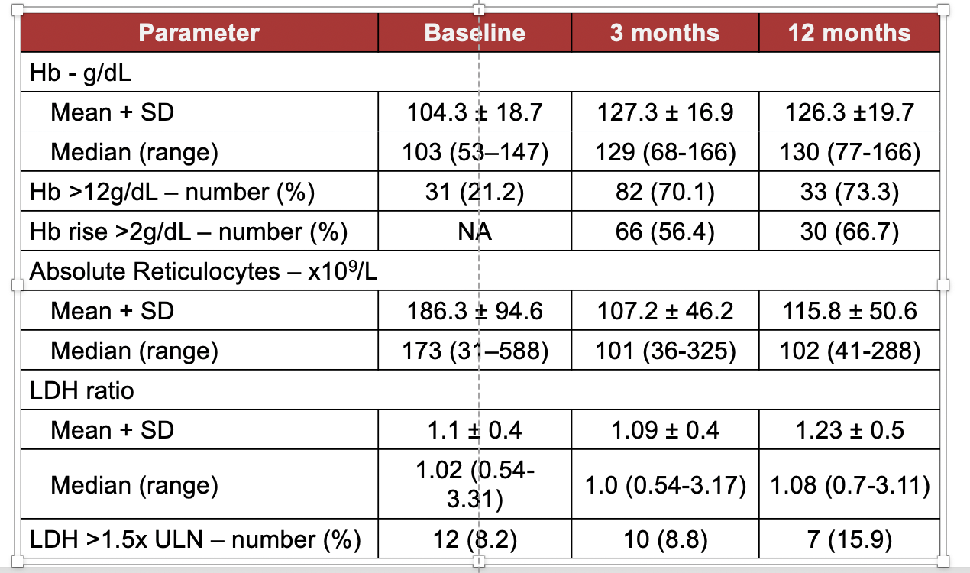
Iptacopan - Real world experience
Retrospective analysis – UK & France - July 2021 and July 2025
Holt et al. ASH 2025

Slide 39


Iptacopan - Real world experience
Retrospective analysis – UK & France - July 2021 and July 2025
> Transfusions
Transfusion independence increased from 66.1% pre-iptacopan to 93.2% during the most recent 6 months on treatment among patients treated ≥3 months
Pre-Iptacopan
Receiving Iptacopan
66.1%
93.2%
Holt et al. ASH 2025

