Slide 1





APLASTIC ANEMIA & SEVERE INFECTIONS
Allogeneic Stem cell transplant: when and how?
Vincent Alcazer, MD, PhD (vincent.alcazer@chu-lyon.fr)
MCU-PH, Université Lyon 1
Department d’hématologie clinique, Hospices Civils de Lyon
Equipe L²IB - INSERM U111/ CNRS UMR5308 - CIRI

Slide 2

DECLARATION DES LIENS D’INTÉRÊT 2021-2026
Art. L.4113-13 du code santé publique
Dr. Vincent ALCAZER – Mise à jour le 19/09/2026
Entreprise / Groupe | Financement congrès | Financement recherche | Conférence rémunérée | Consultant | Comité scientifique | Employé | Actionnaire | Autres
ErvImmune |  |  |  | 2022-2024
SOBI | 2023 |  | 2023, 2025 | 2023-2025
Alexion | 2024 |  | 2026 | 2023-2025
GILEAD |  |  | 2023
Novartis | 2025-2026 |  | 2024 | 2023-2026
Jazz Pharma |  |  | 2023
Notes:
Financement congrès: Financement direct ou indirect ou remboursement de frais de participation à un congrès
Financement recherche: Financement direct ou indirect concernant un sujet de rechercher porté par l’intéressé ou son équipe
Conférence rémunérée: Participation à une conférence rémunérée (orateur, modérateur, comité d’organisaiton…)
Consultant:
Ervimmune: Consultant, SOBI: Financement congrès, conférence rémunérée. Alexion: Financement congrès, consultant. GILEAD: Conférence rémunérée. Novartis: Conférence rémunérée, consultant. Jazz Pharma: Conférence rémunérée.

Slide 3
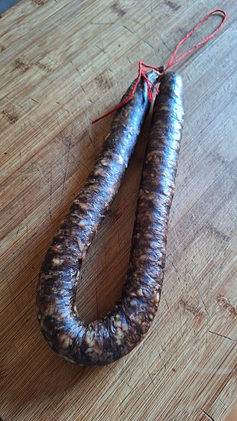
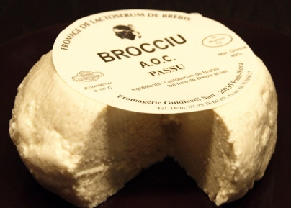
CLINICAL CASE
17-year-old male, no past medical history, recent travel to Corsica
September 2025:
  Progressive purpura over 1 week, followed by hematuria
  Presented to the emergency department of Valence Hospital
CBC: Hb 11.7 g/dL, platelets 3 × 10⁹/L, ANC 0.25 × 10⁹/L
Coagulation, electrolytes and creatinine: normal
Liver panel:
  ALT 1,252 IU/L (>10N), AST 382 IU/L (6-7N)
  GGT 133 IU/L, ALP 112 IU/L, Bilirubin: normal
Bone marrow aspirate: normocellular, reactive-appearing marrow with all lineages well represented; evidence of hemophagocytosis
Abdominal ultrasound: splenomegaly (144 mm)
Transferred to Lyon Sud Hospital for suspicion of hemophagocytic lymphohistiocytosis
Brocciu
Figatellu

Slide 4
Additional work-up at Lyon Sud Hospital
  Clinical examination: height 181 cm, weight 86 kg, BMI 26.5; no history of IUGR, no obvious malformation, no childhood abnormality, no premature graying or nail dystrophy, no skin lesions
  Bone marrow aspirate: markedly hypocellular, no spicules; few granular lymphocytes and plasma cells; hemosiderin-laden macrophages
  Bone marrow biopsy: severe hypoplasia of all three lineages, cellularity <10%; infiltrate of small lymphocytes; EBER (EBV) negative; no fibrosis
  Bone marrow karyotype: failed; FISH negative for −7/del(7q)
  Constitutional karyotype and chromosome breakage test: failed
  Myeloid NGS (130-gene panel): no pathogenic variant
  AFP: 10.6 ng/mL (normal <5.8)
  HbF: normal
  Viral PCR: negative (HSV-1/2, VZV, enterovirus, HBV, HCV, HEV, CMV, EBV, adenovirus, parvovirus B19); HAV serology negative
  PNH clone: 0%
  Telomere length: failed (insufficient sample)
  Ferritin: 1,500 µg/L; triglycerides: 0.9 g/L
  Ongoing molecular testing for IBMF genes (NGS)

Slide 5
DIAGNOSIS?
→ Post-hepatitis aplastic anemia, no evidence of macrophage activation syndrome
→ No matched related donors (only haplo)
→ First line: RACE
  ATGAM 40mg/kg D1->D4
  Ciclosporin (Csa)
  Eltrombopag (ELT)

Slide 6
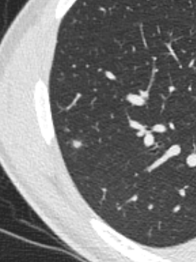
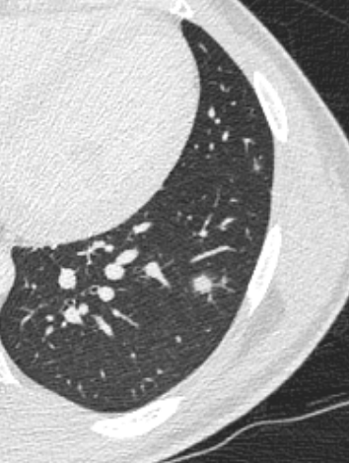
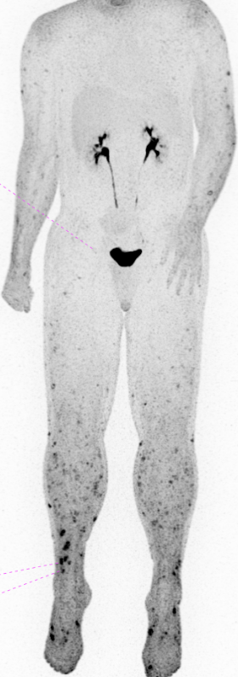
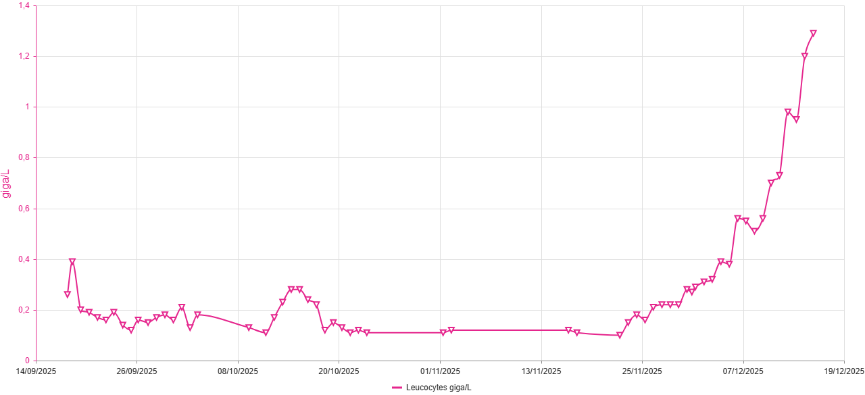
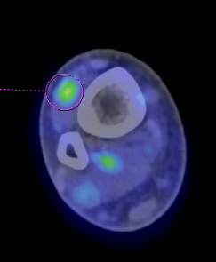
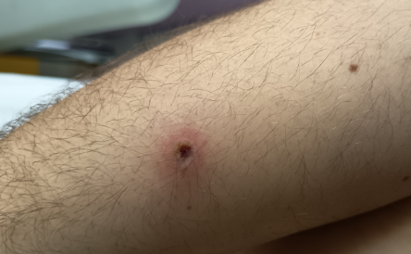
EVOLUTION
D0 ATGAM
03-OCT-25
SUV 3.25
Blood cultures 4/4: Methicillin-susceptible Staphylococcus aureus (MSSA)
Echocardiography : no infective endocarditis
Switch to CEFAZOLIN
Subcutaneous nodules, muscle cramps and myalgia, without rhabdomyolysis
WBC
39°C with chills
TAZOCILLINE + DAPTOMYCINE
Biopsy:
Bacteriology: culture, 16S rRNA PCR & Nocardia PCR negative
Mycology: direct microscopy negative, culture: Fusarium solanii
Negative PCR for Aspergillus & Mucorales spp.
Blood cultures, BD-glucanes, galactomannan all negatives
Dissemination work-up:
Brain MRI: normal
Fundoscopy: peripapillary hemorrhage
FDG-PET: multiple hypermetabolic skin & muscle lesions

Slide 7
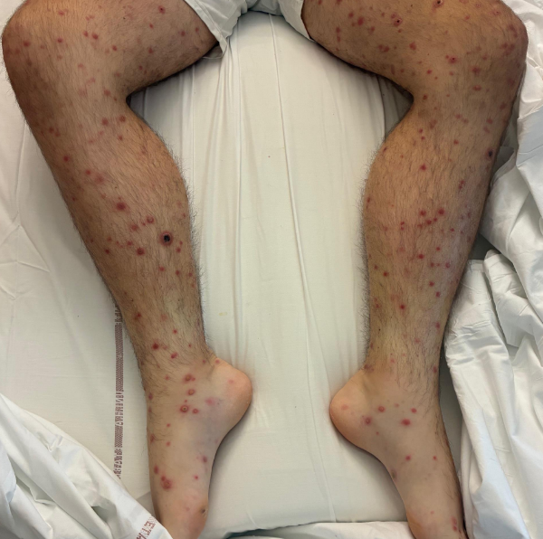
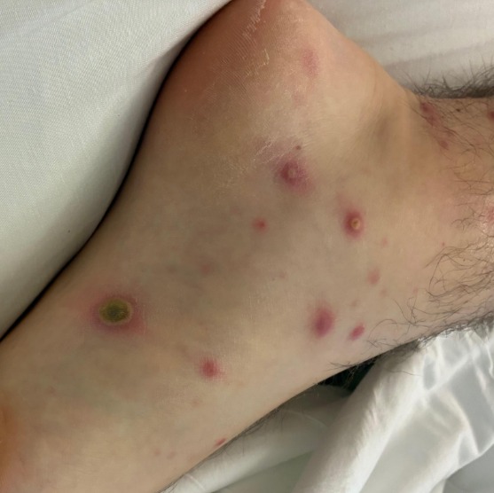
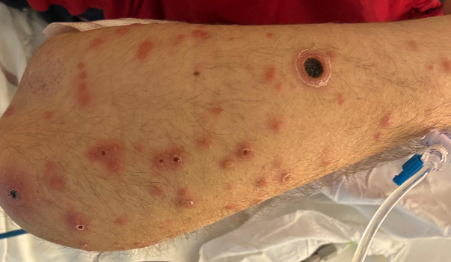
EVOLUTION
D0 ATGAM
03-OCT-25
Fusariosis, 16-OCT: VORICONAZOLE + LINEZOLIDE
MSSA:
CEFAZOLIN
Persistant fever with headache requiring opioids
Lumbar pucture: negative
MEROPENEME, DAPTOMYCINE
VORICONAZOLE + AMBISOME
WBC
TAZOCILLINE + DAPTOMYCINE

Slide 8
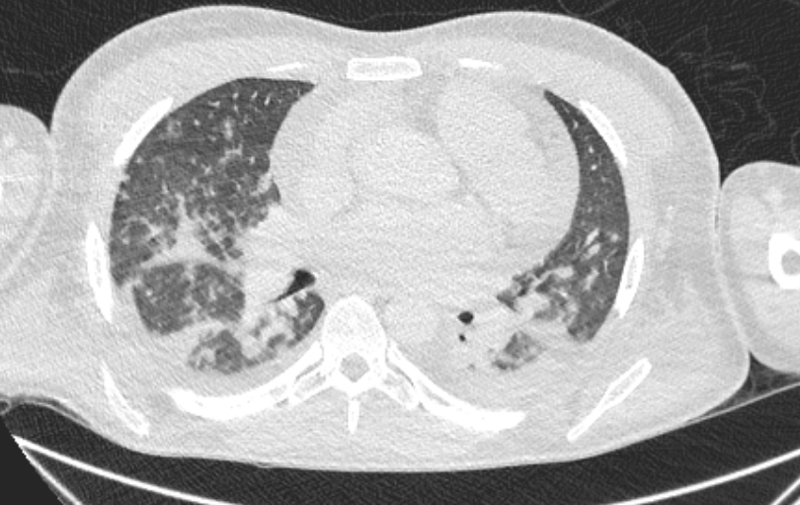
EVOLUTION
03-NOV-25:
10 days of dual antifungal therapy (VORICONAZOLE + AMBISOME)
Persistent fever 39-40°C, CRP 387 mg/L
Psychiatric adverse event (hallucinations, anxiety)
Blood culture still positive for Fusarium
Acute respiratory failure; 4L O2/min
Acute kidney injury, creatinine 130 µmol/L
Sepsis with hypotension, probable macrophage activation syndrome
→ transferred to the Intensive care Unit
06-NOV-25:
Compassionate access for FOSMANOGEPIX, first-in-class GPI inhibitor, stop VORICO/AMBISOME
HYDROCORTISONE for MAS
10-NOV-25:
40°C, New acute respiratory failure → ICU
Blood culture positives for Staphylococcus aureus & Enterococcus faecium
D0 ATGAM
03-OCT-25
Fusariosis, 16-OCT: VORICONAZOLE + LINEZOLIDE
MSSA:
CEFAZOLIN
Persistant fever with headache requiring opioids
Lumbar pucture: negative
MEROPENEME, DAPTOMYCINE
VORICONAZOLE + AMBISOME
WBC
TAZOCILLINE + DAPTOMYCINE
Notes:
Pro-drug of Manogepix
Inhibition gwt1 which is involved in the GPI biosynthesis
Antifungal agent with broad-spectrum activity against yeasts, including Cryptococcus and Candida, as well as molds.
activity against pathogens that typically resist other classes of drugs, such as Scedosporium, Lomentospora prolificans, and Fusarium
excellent oral bioavailability (>90%)

Slide 9
EVOLUTION
25-NOV-25:
Persistent fever 39°C
No new pathogen identified
CRP: 20-50 mg/L
National multidisciplinary discussion:
Wait at least 3-6M for ATGAM response ?
Proceed to haploidentical allogeneic HCT? (No 10/10 MUD, only 9/10)
D0 ATGAM
03-OCT-25
Fusariosis, 16-OCT: VORICONAZOLE + LINEZOLIDE
06-NOV
FOSMANOGEPIX
ICU 1
MSSA:
CEFAZOLIN
WBC
TAZOCILLINE + DAPTOMYCINE
VORICONAZOLE + AMBISOME
ICU 2
Notes:
Pro-drug of Manogepix
Inhibition gwt1 which is involved in the GPI biosynthesis
Antifungal agent with broad-spectrum activity against yeasts, including Cryptococcus and Candida, as well as molds.
activity against pathogens that typically resist other classes of drugs, such as Scedosporium, Lomentospora prolificans, and Fusarium
excellent oral bioavailability (>90%)

Slide 10
QUESTIONS AT THIS MOMENT
1. Is it really an idiopathic, immune-mediated aplastic anemia?
  ~6.6% of patients with AA may have an unrecognized inherited bone marrow failure (McReynolds L. Blood 2022)
  Worse survival after alloHCT (HR, 2.13 [1.40-3.24]; P = .0004), even with RIC
  The excess mortality risk in unrecognized IBMFS is attributed to death from organ failure (HR = 4.88; P < .0001)
2. Can (and should) we transplant a patients with an uncontrolled infection?
3. How to approach severe aplastic patients with uncontrolled infection / inflammatory syndrome?

Slide 11
DIFFERENTIAL DIAGNOSIS
Telomere length: 8.8% [1-10]th percentile, AFP ↑: 10.6 ng/mL (normal <5.8)
Family history
  Sorsby fundus dystrophy in the grandfather (TIMP3 variant), who underwent lung transplantation
  TIMP3 variant carriers without disease among siblings
  No other cases in the family
IBMF NGS panel:
  Heterozygous RPA1 variant of uncertain significance (VUS): NM_002945.5:c.1351G>A, p.(Glu451Lys) (exon 13)
  Rare in population databases (gnomAD allele frequency 4.1 × 10⁻⁶)
  Predicted deleterious by in silico tools
  Not located in the region of previously described gain-of-function variants
Acquired AA or Telomere Biology Disorder?

Slide 12
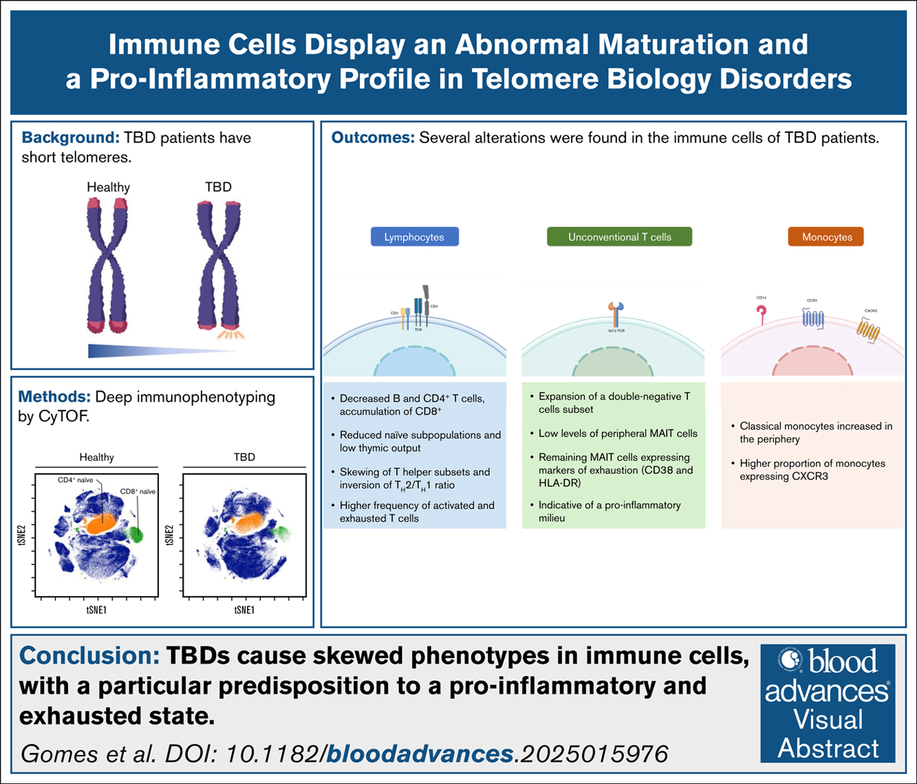
IMMUNE DYSFUNCTION IN TELOMERE BIOLOGY DISORDERS
T-cell lymphopenia characterizes immunodeficiency in a broad spectrum of TBD: Catto L. et al Blood 2025
  88 TBD patients from 6 to 76
  47% with lymphopenia
  Decreased CD3+ T cells, both CD4+ and CD8+, were associated with bone marrow failure, increased infection risk, and reduced survival.
The initial clinical presentation may be with severe immune deficiency
The immune defect is overall very variable
Tummala H. Exp Rev Hematol 2022

Slide 13
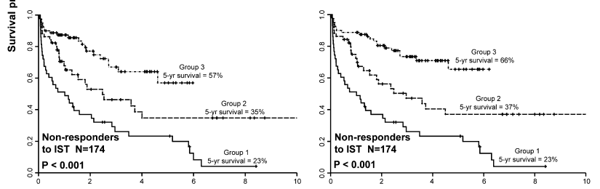
INFECTIONS IN APLASTIC ANEMIA
1990: «Aspergillus as a major cause of death in aplastic anemia »
  Weinberger M. Medicine 1992. N=150 patients du NIH, 83% SAA;
  Documented infections: bacteria (67%), followed by fungi (23%), viruses (7%), and parasites (3%)
  Fungal infections accounted for 55% of fatal infectious event
  Negative impact of low monocyte count (GATA2?)
2010: « decreased infection-related mortality in SAA over past decades »
  Valdez J. CID 2011, N=174pts refractory to IST, comparison over 3 periods
  Infection related death: 37 → 11%; IFIs: 49% → 8%; OS at 5years: 23 % → 57%
HCT censored
1989-1996
1996-2002
2002-2008
Notes:
Profil différent de la neutropénie associée à la chimiothérapie
Neutropénie prolongée (opportunité infection respi / aspergillus)
Pas d’altération des muqueuses (moins d’entérobactéries)

Slide 14
CAN (AND SHOULD) WE PROCEED TO HCT WITH AN ACTIVE INFECTION?
Design | Resultats | Référence
N=65 SAA 2012-2016 Controlled infection (CR, n=14) vs stable or partially controlled (PR/SD, n= 51) | - Same overall caract. - 3y OS: 92,9% (CR) vs 85,4% (PR) p=0,53 - Engraftment: 100 vs 98% (p=0,78), same median time (~10days) - Only ECOG 3 was associated with worse outcome in multivariate analysis | Xu S et al. BBMT 2018
N=327 SAA with infection AlloHCT (n=141) Vs no allo (n=186, no donor) | - Allo group older (age 26 vs 12), more pulmonary and less controlled infections (23% vs 84%), - Less grade3-4 infection-related death: 18,5 vs 33,3% (p=0.036) - Hematologic recovery at M6: 91% (HCT) vs 8,78% - OS at 6y = similar (75%) | Liu et al. Front Immunol 2022
N= 255 SAA alloHCT n=66 with infection vs 189 without infection | - More VSAA (59vs31%) and PBSC (89vs76) in the infection group - 5y OS: 63% vs 86% (p=<0.001) - Lower 28-day neutrophil / platelet engraftment - Primary cause of death = infection (16% vs 4%) - Haplo-HCT and pre-HCT infection response = adverse factor for OS in multivariate analysis | Zhang Y et al. Front Immunol 2022
« We can »
« We should »
« Absolutely
No! »
Notes:
Xu: « c’est faisable »
Overall caract = similar, median age 29, 90% PB+BM, 35% sibling, 57% haplo (CR) vs 51 (PR)
Liu: « moins de TRM »: Multivariate analysis showed that younger age, lower grade of infection (grade 1-2), and SAA (vs. very SAA) were favorable factors for OS (P < 0.05), and that the choice of HSCT and younger age were favorable factors for FFS (P < 0.0001).
NB: conditionning = FLU-CY-ATG (ou ATLG) si MRD/UCB; BU-CY si haplo?!!
NB: no allo = refus ou pas de donneur. IST after infection control. rATG + Csa + G-CSF
Median age no allo = 12 vs 26 groupe Allo!
Zhang: SAA patients with infection defined as PR or SD but not complete remission before allo-HSCT showed inferior survival compared with patients without infection.
plus de VSAA dans le groupe infection
Patients with an MRD and UCB donors were treated according to the FLU/CY-based regimen which consisted of the
following: Fludarabine (FLU), 30 mg/m2/day intravenously (i.v.) on day −7 to −2; cyclophosphoramide (CY), 50 mg/kg/day i.v. on
day −4 to −3; and antithymocyte immunoglobulin (ATG, rabbit, Thymoglobuline®, Genzyme, Cambridge, MA, USA), 2.5 mg/kg/
day i.v. on day −8 to −4, or antilymphocyte immunoglobulin (ALG, porcine,Wuhan Institute of Biological Products, China), 20
mg/kg/day i.v. on day −8 to −4, or anti-thymocyte globulin of Fresenius (ATG-F), 5 mg/kg/day i.v. on day −8 to −4. Patients
with UDs or haploidentical donors were treated according to the BU/CY-based regimen which consisted of the following: Busulfan
(Bu), 3.2 mg/kg/day i.v. on day −7 and −6; CY, 50 mg/kg/day i.v. on day −5 to −2; and ATG, 2.5 mg/kg/day i.v. on day −5 to −2, or
ALG, 20 mg/kg/day i.v. on day −5 to −2, or anti-thymocyte globulin of Fresenius (ATG-F), 5 mg/kg/day i.v. on day −5 to −2.

Slide 15
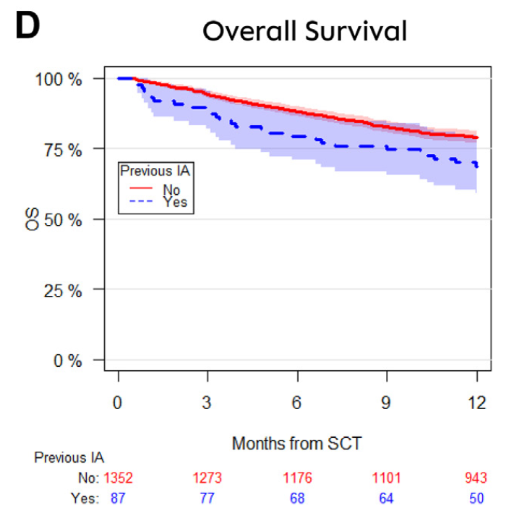
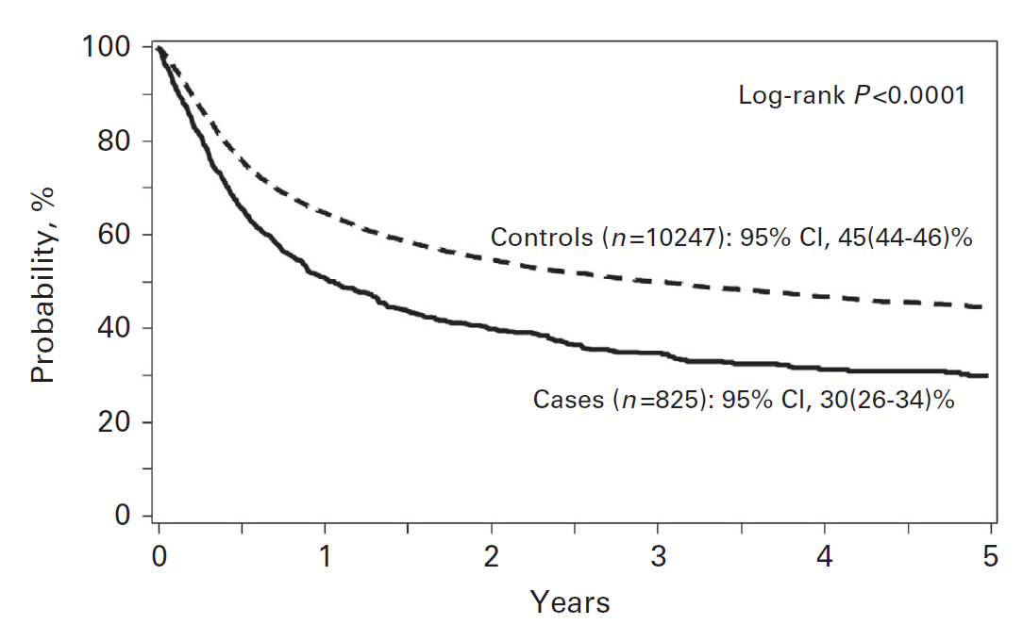
STEM CELL TRANSPLANT WITH ACTIVE IFI: POSSIBLE BUT RISKY
N=825 pts with pre-transplant IFI vs 10247 controls (CIBMTR study)
  Aspergillus spp. & Candida spp. ++
  68% primary pulmonary involvement
  Cases = older, defavorable PS, more AML, more cord blood…
  Median time to transplant: 3 Months
N=1439 AML pts
  6% (n=87) with probable or proven invasive aspergillosis compared to pts without
  1year NRM: 17,3% vs 11,2% (p=0.009*)
  1year RFS: 59,4% vs 70,4% (p=0.02*)
  1year OS: 68,8% vs 79,0% (p=0.01*)
*Multivariate model
Overall survival
45%
30%
Maziarz RT BMT 2016
Penack O. eClinical Med 2024
Notes:
Maziarz: « Pre-existing invasive fungal infection is not a contraindication for allogeneic HSCT for patients with hematologic malignancies: a CIBMTR study »
50 ‘other’ fungal infections, including Mucormycosis, Fusarium and Cryptococcus.
Median time from infection to transplant = 3 M
Details of the status of the IFI at time of transplant were not available in the CIBMTR
database.
The lower OS was a composite reflection of higher relapse rates and higher NRM in the cases
Less aGVHD and cGVHD in IFI group?
on multivariable analysis, cases with pre-transplant IFI had
higher overall mortality (relative risk (RR) 1.33, 95% CI (1.19–1.48), Po0.0001)
Shorter PFS at 2 years (RR of relapse or death 1.24, 95%CI (1.11–1.38), Po0.0001)
Significant increases in NRM (RR 1.27 (1.09–1.49), P=0.002)
Penack O:
Summary
Background Infections are the main reason for mortality during acute leukaemia treatment and invasive aspergillosis
(IA) is a major concern. Allogeneic stem cell transplantation (alloSCT) is a standard therapy and often is the only livesaving
procedure in leukaemia patients. The profound immunodeficiency occurring after alloSCT led to high IAassociated
mortality in the past. Therefore, patients with IA were historically considered transplant-ineligible.
Recently, there has been improvement of anti-fungal management including novel anti-fungal agents. As a result,
more leukaemia patients with IA are undergoing alloSCT. Outcome has not been prospectively assessed.
Methods We performed a prospective study in acute leukaemia patients undergoing alloSCT to analyse the impact of
a prior history of probable or proven IA (pre-SCT IA). The primary endpoint was 1-year non-relapse mortality (NRM).
Relapse free survival and overall survival were analysed as secondary endpoints.
Findings 1439 patients were included between 2016 and 2021. The incidence of probable or proven pre-SCT IA was 6.0%
(n = 87). The cumulative incidence of 1-year NRM was 17.3% (95% CI 10.2–26.0) and 11.2% (9.6–13.0) for patients with
and without pre-SCT IA. In multivariate analyses the hazard ratio (HR) for 1-year NRM was 2.1 (1.2–3.6; p = 0.009) for
patients with pre-SCT IA. One-year relapse-free survival was inferior in patients with pre-SCT IA (59.4% [48.3–68.9] vs.
70.4 [67.9–72.8]; multivariate HR 1.5 [1.1–2.1]; p = 0.02). Consequently, 1-year overall survival was lower in patients
with pre-SCT IA: (68.8% [57.8–77.4] vs. 79.0% [76.7–81.1]; multivariate HR 1.7 [1.1–2.5]; p = 0.01).
Interpretation Pre-SCT IA remains to be significantly associated with impaired alloSCT outcome. On the other hand,
more than two thirds of patients with pre-SCT IA were alive at one year after alloSCT. IA is not anymore an absolute
contraindication for alloSCT because the majority of patients with IA who undergo alloSCT benefit from this procedure.

Slide 16
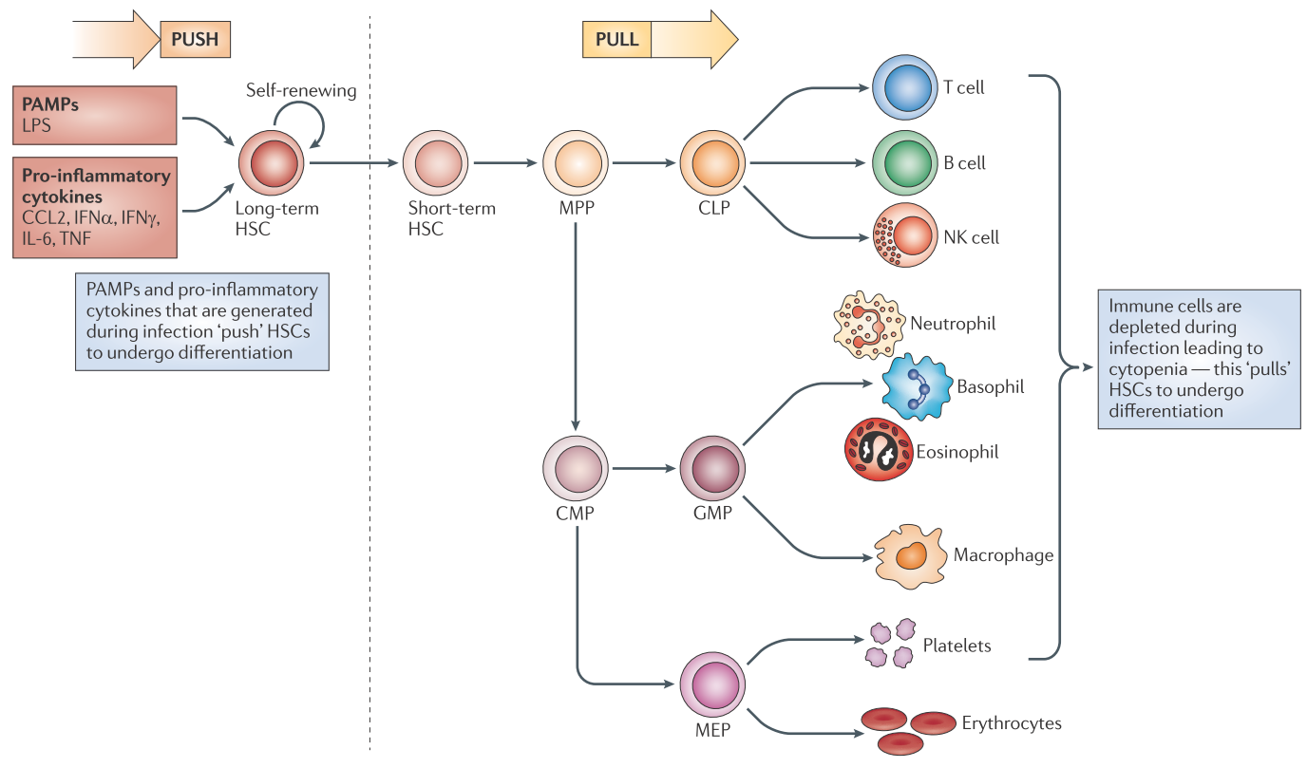
NEGATIVE IMPACT OF INFLAMMATION ON HEMATOPIETIC STEM CELLS
King K. & Goodell M. Nat Rev Immunol 2011
Notes:
IFNy alone can cause AA (Lin F. Blood 2014)
IFNa and y drive HSC collapse by causing DNA damages (Exit from dormancy provokes DNA-damage-induced attrition in haematopoietic stem cells, Walter D Nature 2015)
Hematopoietic exhaustion caused by chronic IFN-g signaling is severely accelerated in inherited BMF syndromes (IBMFs)

Slide 17
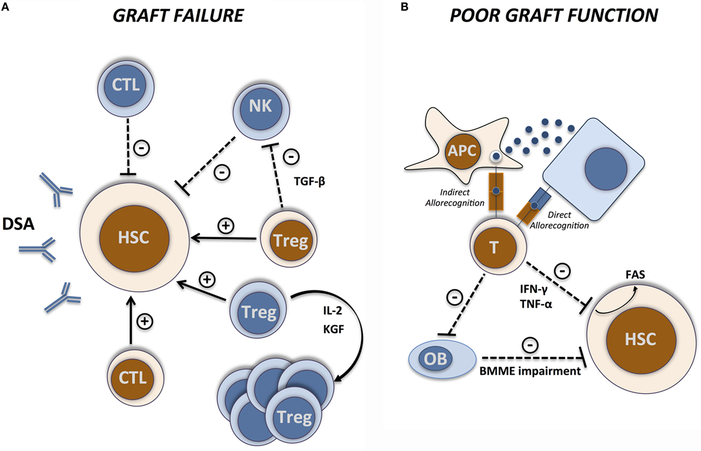
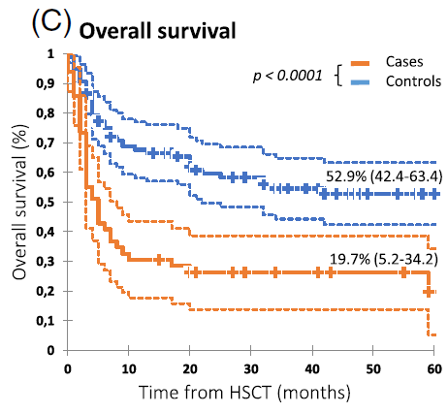
INFECTION AS A RISK FACTOR FOR GRAFT FAILURE
N=49 graft failure vs 98 matched-controls
Early-onset severe infection = life-threatening infection between D-7 and D42
Association with graft failure: OR 11.04; 95%CI [3.86-31.61]; P < 0.0001 (+++ for IFI)
PGF seems to be essentially the result of a sustained impairment of hematopoietic stem cells (HSC) self-renewal and proliferation caused by inflammatory mediators, such as interferon-γ (IFN-γ) and tumor necrosis factor-α, and of induction of apoptosis through the Fas/Fas ligand pathway
Alcazer V. AJH 2019
Masouridi-Levrat Front Immunol 2016
Mattsson BBMT 2009

Slide 18
OUR PATIENT’S EVOLUTION
ANC>0,5
12-DEC-25
X
D0 ATGAM
03-OCT-25

Slide 19
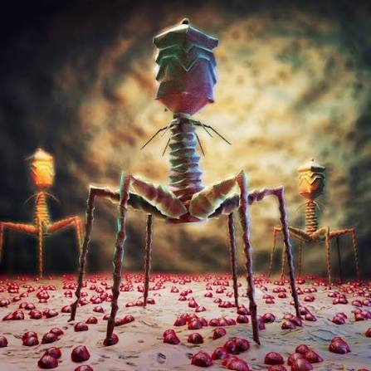
TAKE HOME MESSAGE
CAN WE proceed to alloHCT under active infection?
  Feasible… but risky
  No robust study to date
  We CAN, but SHOULD we?
HOW to transplant a patient with an active infection?
  1. Ensure a correct diagnosis: immunologic vs inherited BMF
  2. Optimize infection control
    Collaboration with infectious disease department
    Access to new therapies (fosmanogepix, phages…)
    Role of pre-emptive therapies & prophylaxis
  3. Discuss optimal procedure
    Adapt conditioning according to acquired / inherited BMF
      Impact of peripheral blood stem cell: negative impact on OS ++ (Bacigalupo Haematologica 2015), but in that particular setting?
    Donor availability
→ Use of granulocytes as a bridge to transplant?
Notes:
Impact of peripheral blood stem cell: negative impact on OS ++ (Bacigalupo Haematologica 2015), but in that particular setting?

Slide 20



CENTRE DE COMPÉTENCE APLASIE/HPN RÉGIONAL
CeRAMIC - Centre de référence des aplasies médullaires idiopathiques et constitutionnelles
Adulte
Dr Vincent ALCAZER
Pédiatrique
Dr Cécile RENARD
Lille
Développement du réseau régional
Amélioration du diagnostic sur le territoire (plaquettes info HPN pour les centres périphériques
Communication autour des essais cliniques ouverts
Base de données régionale
Journées de formation AURA aplasies/HPN
  1ère = janvier 2024 à Lyon, 2ème en 2027?
Robert Debré
Strasbourg
Saint Louis
Nancy
Rennes
Nantes
Avis complémentaires
RCP locale pour les validations « simples » (iC5 en première ligne, évaluation indication greffe etc…)
Accès essais cliniques, nouveaux traitements…
Complément rapide de la RCP nationale
Lyon
Bordeaux
Organisation du suivi
Suivi patient dans les centres de périphérie
Centralisation si besoin de la surveillance médullaire
Nice
Marseille
Toulouse
Centre de référence national
Centre de compétence régional

Slide 21



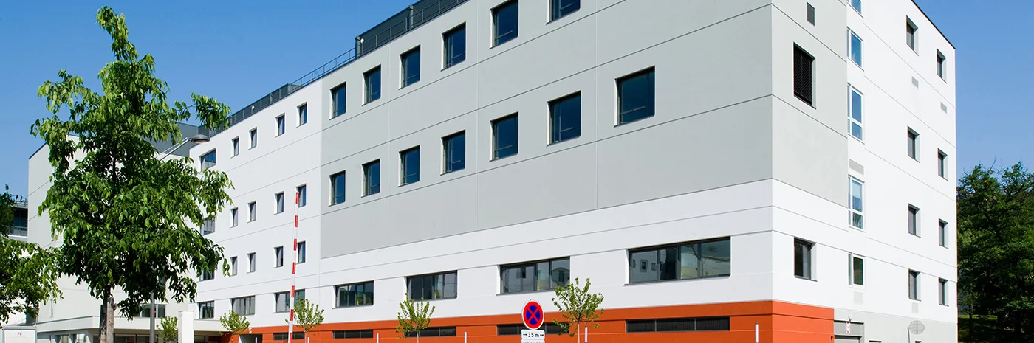
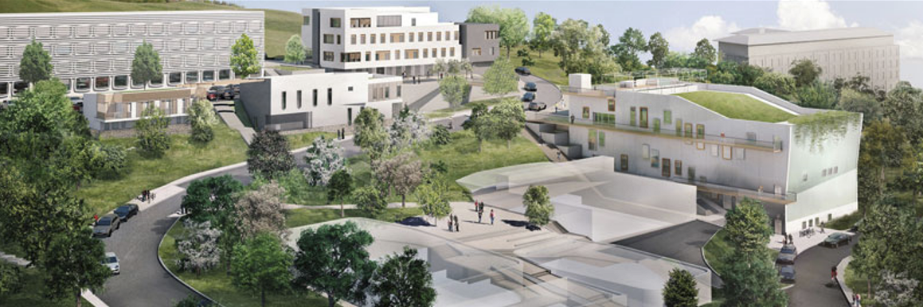
MERCI POUR VOTRE ATTENTION
Hôpital Lyon Sud, HCL
Faculté de médecine Lyon Sud
Service d’hématologie clinique
Myéloïde // Lymphoïde
Pr Hervé GHESQUIERES – Chef de service
Pr Emmanuel BACHY – Chef de service adjoint
Dr Hélène LABUSSIERE – Cheffe de service adjoint
Dr Maël HEIBLIG – MCU-PH
Dr Vincent ALCAZER – MCU-PH
Equipe de recherche LIB
Groupe myéloïde
Inserm U1111/CIRI
Dr Laurent GENESTIER – Directeur unité de recherche
Pr Emmanuel BACHY – Codirecteur

Slide 22
COMING BACK TO ALLO-HCT
CAN WE?
  Yes but it is risky, balance
WHEN?
  If possible: when the infection is controlled
  Buit what if the infection is never controlled?
HOW?
  Impact of peripheral blood stem cell: negative impact on OS ++ (Bacigalupo Haematologica 2015)
  Difference AA vs IBMF

Slide 23
LA RÉPONSE IMMUNE DANS L’APLASIE
Aplasie acquise vs constit
Sévérité des infecitons surrogate du type d’aplasie?
Effet de l’ATGAM?

Slide 24
QUAND ? — LA COURSE CONTRE LA NEUTROPÉNIE
Immunosuppression ou greffe chez l'infecté ?
IMMUNOSUPPRESSION (HATG + CSA + ELT)
ALLOGREFFE
≈ 3 mois
≈ 10 jours
Réponse médiane sous triple thérapie ; l'ATG ajoute une immunosuppression pendant l'infection
Prise de greffe myéloïde médiane chez des aplasiques infectés (Xu 2018), si le greffon prend
18,5 % vs 33,3 %
> 180 jours
Mortalité liée au traitement (infections grade 3–4), greffe vs non-greffe ; survie à 6 ans identique — rétrospectif, biais de sélection
Intervalle diagnostic–greffe : 2e facteur prédictif négatif de survie (EBMT, 1448 patients)
Sources : PNDS CRMR 2023 ; Xu S, BBMT 2018 ; Liu L, Front Immunol 2022 ; Bacigalupo, Haematologica 2015
Notes:
Rationnel physiopathologique (raisonnement, non démontré) : l'IST ne corrige pas la neutropénie avant plusieurs semaines à mois et l'ATG ajoute une immunosuppression ; la greffe apporte une prise myéloïde en 2 à 3 semaines, au prix du risque de non-prise. PNDS 2023 : réponse médiane d'environ 3 mois sous hATG-CsA-eltrombopag (RACE, NEJM 2022, grade A) ; le délai de traitement a un impact pronostique. Liu 2022 : en cas d'infection grade 3–4, mortalité liée au traitement 18,5 % (greffe) vs 33,3 % (non-greffe), p=0,036 ; survie à 6 ans ≈ 76 % dans les deux groupes. Biais : les patients greffés étaient ceux jugés greffables. Bacigalupo 2015 (EBMT, 1448 patients) : greffon CSP puis intervalle diagnostic–greffe de plus de 180 jours sont les deux premiers facteurs prédictifs négatifs de survie.

Slide 25
TIMING
Neutrophil recovery:
  ~3M post ATGAM
  ~10 days post-HCT (Xu S, BBMT 2018 ; Liu L, Front Immunol 2022 ; Bacigalupo, Haematologica 2015)
  Facteur de risque de non prise de greffe? (Alcazer V, AJH 2019)
    Early-onset severe infection = life-threatening infection between D-7 and D42
    Association with graft failure: OR 11.04; 95%CI [3.86-31.61]; P < 0.0001

Slide 26
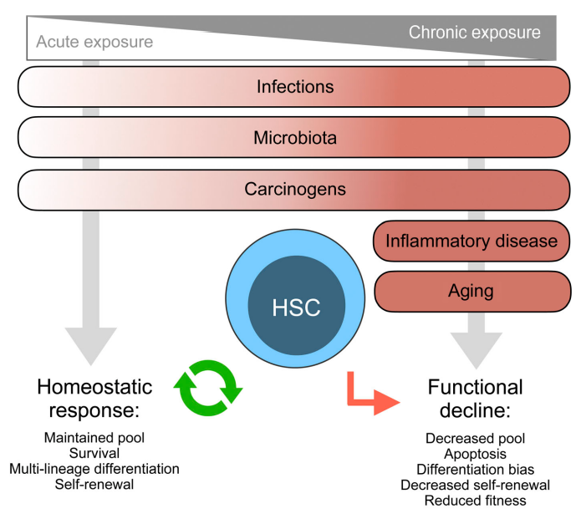
INFLAMMATION & INFLAMM-AGING
Drives mutant HSC
Selection & Expansion
Caido F. J Exp Med 2021
Notes:
Acute exposure of type I IFN inducer polyinosinic:polycytidylic acid (polyI:C) or IFN-α itself can drive proliferation of dormant HSCs through a pathway dependent on the IFN-α/β receptors
IFNAR and STAT1 that associated with increased MYC protein level, decreased expression of quiescence-enforcing genes, and increased mitochondrial ROS-induced DNA damage
HSCs remain protected from the p53-dependent proapoptotic effects of type I IFNs so long as they remain quiescent
Acute IFN-γ exposure drives HSC proliferation via IFNGR and STAT1; associates with Fas-mediated apoptosis. like type I IFNs, is associated with reduced repopulation capacity

Slide 27
Evaluation à Lyon Sud
Nouveau bilan
  Cliniquement: 181cm 86 kg IMC 26,5, pas de RCIU, pas de malformation évidente, pas d’anomalie dans l’enfance, pas de canitie précoce ou de dystrophie unguéale, pas de lésions cutanée
  Myélogramme: sang médullaire désertique sans grains, quelques lymphocytes à grains et plasmocytes, macrophages chargés d’hémosidérine
  Biopsie ostéo-médullaire: hypoplasie majeure des 3 lignées, richesse < 10%, infiltrat lymphoïde de petits lymphocytes, EBER EBV négative, pas de fibrose.
  Caryotype médullaire: échec, FISH négative (-7/7q-)
  Caryotype constit avec test cassure: échec
  NGS myéloïde: négatif (panel 130gènes)
  AFP: 10,6 ng/mL (N<5,8)
  HbF: normale
  PCR virales: négatives (HSV1,2, VZV, Enterovirus, VHB, VHC, VHE, CMV, EBV, ADV, PB1), séro VHA-
  Clone HPN: 0%
  Longueur des télomères: échec (prélèvement trop pauvre)
  Ferritine 1500 µg/L, triglycérides 0,9g/L

Slide 28
EVOLUTION
D0 ATGAM
03-OCT-25
Dissemination work-up:
Brain MRI: normal
Fundoscopy: peripapillary hemorrhage
FDG-PET: multiple hypermetabolic skin & muscle lesions
Blood cultures 4/4: Methicillin-susceptible Staphylococcus aureus (MSSA)
Echocardiography : no infective endocarditis
Switch to CEFAZOLIN
Subcutaneous nodules, Fusarium spp.
LINEZOLIDE, TAZOCILLINE,
VORICONAZOLE
39°C with chills
TAZOCILLINE + DAPTOMYCINE
SUV 3.25

Slide 29
EVOLUTION AVEC LE TEMPS
N=174pts réfractaire IST
Group 1: 1989-1996
Group 2: 1996-2002
Group 3: 2002-2008
Baisse de
- La mortalité liée aux infections (37 -> 11%)
- IFIs (49 -> 8%)
Augmentation de l’OS de 23 -> 57% à 5 ans chez les non répondeurx aux IST
HCT censored
Valdez J. CID 2011
Notes:
mprovement in survival over time. Five-year survival is depicted for all patients (first row), responders to immunosuppressive therapy (IST)
(second row), and non-responders to IST (third row). Six-month survival, as a surrogate for neutropenia, in non-responders to IST is presented in the fourth
row. The first column depicts hematopoietic stem cell transplantation (HSCT)–censored Kaplan-Meier survival curves and the second column HSCT non-
censored curves. Overall survival for all patients was improved in group 3 (first row) compared with groups 1 and 2. Among responders to
immunosuppressive therapy, no difference in survival was noted over time (second row). Among non-responders, a marked improvement in survival
occurred in group 3, compared with survival in groups 1 and 2 (third row). The 6-month survival after IST among non-responders was also markedly higher
in group 1 than in group 3 (fourth row).

